Slide 1
Shortest Path and Navigation
Shortest Path Problem
Dijkstra Algroithm
Apply to Navigation
Techniques for High-Speed
Bellman-Ford Algorithm for Negative Cost

Slide 2
Shortest Path Problem
• ネProblem of finding the shortest way (path) from a point to another point (or all other points) in a network
• Geometric maps can be converted to a discrete structures by considering crosses as vertices and roads and streets as edges connecting crosses and crosses
• Used in navigation system

Slide 3
Shortest Path cond.
Input: a network, edge distance, origin, destination
Output: an edge set, forming a path
objective: minimize the sum of distance of the path to be output
constraints: edge set output has to be a path

Slide 4
Characteristics
• Utilized in many scenes in real world
• Used as tools for solving other problems
• Can be formulated as a linear programming, minimum cost flow (thus, being a special case of them)
• Dijkstra algorithm works with almost linear time when all distances (costs) are non-negative
• Bellman-Ford algorithm allows negative costs, with taking O(#vertices × #edges)
• Many algorithms had been proposed to improve the practical performance

Slide 5
Dijkstra Algorithm
• Computing the distance to vertices, in the increasing order of the distance (so, vertices are found in their “rank”, nearest, second nearest, …)
10
20
5
8

Slide 6
Property Needed in Dijkstra
• Look at the shortest path to the k-th nearest vertex
• the rank (much it is near to red) of green vertex is less than k
in the shortest path

Slide 7
The Property
• Suppose that we got vertices up to k-1th nearest, and the distances to them
• 距which/how is the kth vertex/distance to it?
10
10
13
20
5
8
8
Among the blue vertices
Minimum among those reached by red edges

Slide 8
Way of Dijkstra
• Dijkstra finds the k-th nearest vertex one by one in this way
• Use a heap to find the shortest distance one among red edges

Slide 9
Code for Dijkstra
• e[v][0],…,e[v][ez[v]-1], for storing vertices adjacent to v
• c[v][0],…,c[v][ez[v]-1], the (total)distance to these vertices
• HEAP_chg (v,p), function for changing the value h[v] to p, where h[v] is the cell of v of the heap
Dijkstra (int **e, int *ez, int **c, int s, int t){
int i, j, d;
for ( i=0 ; i<n ; i++ ) HEAP_chg( i, HUGE);
HEAP_chg( s,0 );
while (1){
v = HEAP_ext ();
if ( v = = t ){ printf (“shortest distance is %d\n”, ); exit(0); }
if ( h[v] == HUGE ){ printf (“not reachable\n”); exit(1); }
for ( i=0 ; i<ez[v] ; i++ ){
if ( h[e[v][i]] > h[v]+c[v][i] )
HEAP_chg (e[v][i], h[v]+c[v][i] );
}
}
}

Slide 10
Time Complexity of Dijkstra
• In the k-th iteration of Dijkstra, we do
① find and remove the min. distance one e among candidates
② if the vertex v connected to the edge e is not visited,
③ compute the distance for all edges incident to v
④ insert the edges to the candidate set
• No edge is inserted to candidate set more than once
→ executions of ③&④ is at most (# of edges) times
• the number of removal does not exceed that of insertion
→ executions of ① is at most (# of edges) times
• Heap needs O(log #edges) time for one operation
→ total computation time is O(#edges × log #edges)

Slide 11
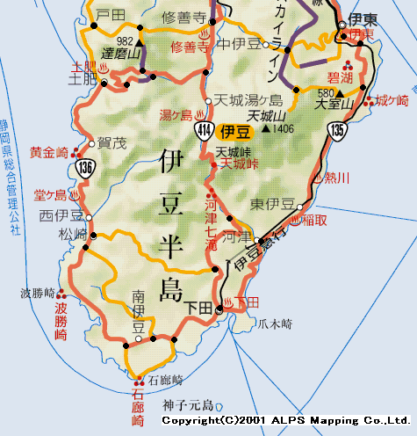
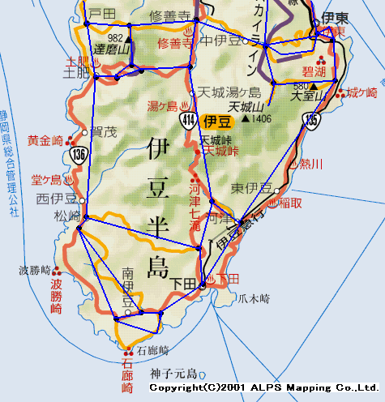
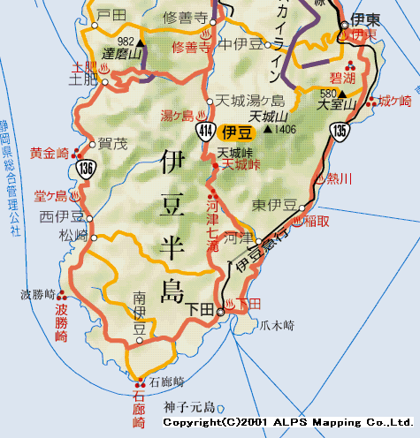
Navigation System
• We want to know the shortest path from here to the destination
• Convert the map to network, and find the shortest path

Slide 12
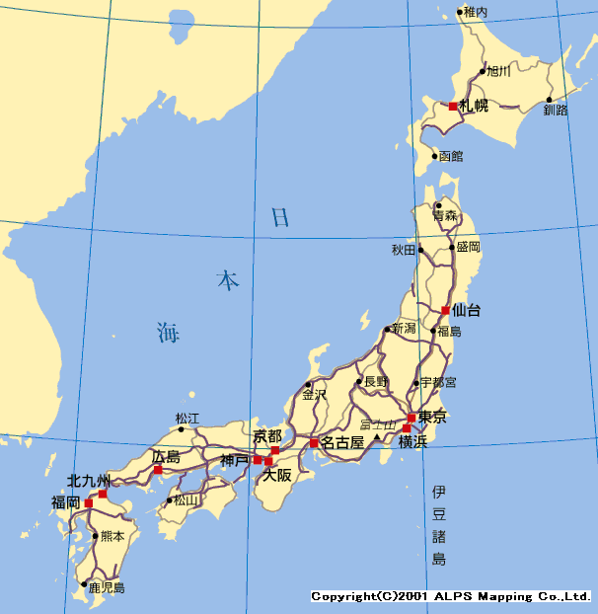
A Problem
• The shortest path to far place needs to load much, too much data.
← Dijkstra visits all points nearer than the destination

Slide 13
Two Way Search
• Execute Dijkstra’s from the origin and the destination, simultaneously
• We Find the shortest path when they meet

Slide 14
Improved, a little
• The area to be loaded becomes almost half

Slide 15
Meeting Point, in Exact
• Put marks to visited vertices by Dijkstra from both origin and destination, and stop when a vertex gets marks from both
• Compare all paths passing through the edges connecting vertices with marks, and also the vertex, and choose the minimum one
(ignore the pass passing through other edges and vertices)

Slide 16
Proof
• Suppose that the rank of the meeting vertex is k from the origin (k-th nearest) with distance d, and k’th with distance d’
➔ then, we get a path from origin to destination of distance d+d’, by just concatenating
• A vertex v not visited by both, has ranks ≥ k from origin, and ≥ k’ from destination
➔ distances from origin/destination is ≥ d, ≥ d’
➔ any path passing through k cannot be shorter than d+d’
➔ no need to care
≥ d
≥ d’
d
d’

Slide 17
Use Geometric Property
• Dijkstra algorithm uses no information from geometric structure of the problem
⬅ we don’t search to the direction opposite to destination
• Give priority to search directed to the destination
• But, we want to keep the increasing order of visit, to be in the Dijkstra algorithm framework
➔ Trade off; increasing order of this,
(distance from the origin) + (direct distance to the destination)

Slide 18
A* Algorithm
• (distance from the origin) + (direct distance to the destination)
increasing order of this leads the search to the direction to the destination
• We can prove the correctness by using
real distance ≧ direct distance
(a lower bound of real distance is sufficient)

Slide 19
Improved, more
• Data load got reduced much

Slide 20
Proof for A* Algorthm
• Suppose that A* finds a non-optimal path X
• Let v be the first vertex of the shortest path from the origin, to which the path found by A* is different from the shortest path
Let u be the vertex of the shortest path just before v
➔ u was not visited, when v was visited
to determine the path to v
otherwise, the edge (u, v) has shorter
(distance from origin) + (direct distance to dest.)
v
u

Slide 21
Proof of A* (cond.)
• Compare the following two
(distance from origin to v) + (direct distance from v to dest.)
(distance from origin to u) + (direct distance from u to dest.)
u has to be visited
earlier than v

Slide 22
More Greedy A* Algorithm
• In reality, the direction to the destination has more priority
➔ give more attention to the direct distance to destination
• Use (distance from origin) + (direct distance to dest.) ×α (α>1)
• Actual distance ≧？ direct distance ×α
➔ the proof collapse
×α
• Possibly fail, but rarely happens
• Search space is reduced more

Slide 23
Use Two Layers
• We usually use some by-pass or highway, move to far places
➔ Shall we skip small road at the middle of origin and destination
• On the other hand, small roads
are important near by origin
and destination

Slide 24
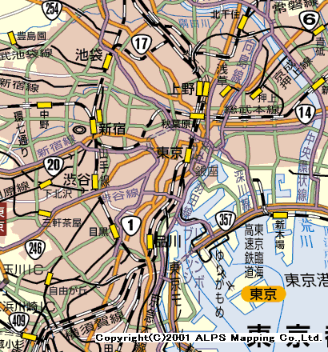
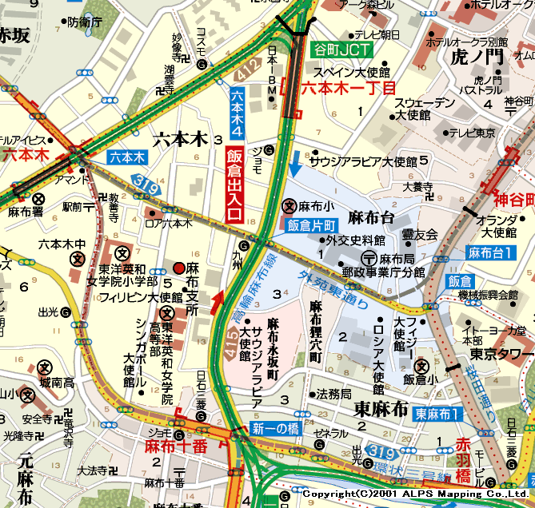
Layers for Big/Small Roads
• Partition the road network into two
① Layer for highways, by-pass and main streets
② Layer for all roads
How do we connect two layers

Slide 25
The Usage of Layers
① Find the entrance of highway, nearest to the origin
② Find the exit of highway, nearest to the destination
③ Find the shortest path from the entrance to the exit
Nearest entrance/exit does not always give the best

Slide 26
Advanced Usege
① Find the entrances of highway and the shortest paths from origin to them, that are near by the origin
② Find the exits of highway and the shortest paths from them to destination, that are near by the destination
③ Find shortest paths between entrances and exits

Slide 27
Define Layers Mathematically
• The classification to layers depends on the labels of the roads given by humen
➔ can we mathematically define?
➔ can we make a model without loss of optimality?
• Characterize the roads, that are used in the middle of the shortest paths connecting distant origins and destinations

Slide 28
Long Distance Travel
• Layer method takes reduces the edges to be cared in the middle of the search, to go to far places
➔ Extract all edges that can be used in the middle of searches
• The computation cost is the problem
⬅ Navigation use the result many times, so the heavy preparation does not matter
• We consider some methods
takes much cost but select such
edges perfectly

Slide 29
Construct highways
• Consider search result by Dijkstra algorithm starting from s
－ regard edges connected to vertices of rank at most k from origin or destination ”for short distance”
－ the other edges in some shortest path “for long distance”
• Dijkstra search from each vertex until rank k, then we obtain all edges for long distance
➔ Use only long distance edges after rank k in the Dijkstra search
rank k

Slide 30
Highway Hierarchies
• Now highways are defined mathematically
• Then, how do we choose a good k, for define the highway?
－ much cost to get highway, when k is large
－ highway network becomes dense, when k is small
• The answer is, “choose small k, apply the highway definition recursively to the dense highway
• Layers gets smaller exponentially

Slide 31
Connection between Highways
• Highway layers are densely connected
➔ Upper layer becomes sparse by shrinking degree-2-vertices, but the corresponding lower layer has many vertices and edges to be connected
• The connection to intermediate vertices changes their connection to the end vertices

Slide 32
Bit Vector: Considering Direction (Area)
• Highway Hierarchy considers distance but not the direction
➔ Consider the direction and place of the destination
• Actually, direction is hard to handle, thus we consider the area of the destination
➔ We divide the map into areas, and consider some for each area

Slide 33
Squeeze according to Area of Destination
• For each pair of vertex and area, we list edges incident to the vertex possible to use to go some point in the area
(by looking at shortest paths to all the vertices in the area)
➔ In the search, we use only such edges
➔ Search space is reduced drastically
• Problem on the heavy cost for preparation, and memory usage

Slide 34
An Example of Bit Vector
• Almost no choice until middle of the search, then expand a little by getting closer to the destination

Slide 35
Considering Negative Cost
• Dijkstra collapses
(We see sometimes such negative costs in applications other than navigations, and road network)
-2
1
1
-1
How do we solve such problems?

Slide 36
Admitting Negative Costs
Bellman-Ford Algorithm
Idea Dijkstra may produce wrong distance
➔ correct them when we find
① Put +∞ to all the vertices as temporal distance from the origin put 0 to the origin ⬅ this is exact, not temporal
② Looking at each edge, and update the distance if that is shorter
③ End when there is no update
10
0
＋∞
30
10
20
10
-20

Slide 37
No solution, by Negative Cycle
• There is no optimal solution when there is a cycle whose total cost is negative
⬅ We can decrease the cost infinitely by circulating the cycle infinitely many times
-20
4
10

Slide 38
Computation time of Bellman-Ford Algorithm
• We look at each edge and update the temporal distance
↑ after (#vertices) execution of this, we have no updates
Proof:
• The k-th edge of a shortest path is updated correctly at least until k executions
• The length of path ≦ # vertices
➔ All updates will be done after (#vertices) executions
0
10
-10
-5
10
-20
5

Slide 39
Exercise
• Compute shortest path from red vertex to brawn vertex by Bellman-Ford algorithm
10
4
0
5
5
4
20
-2
20
12
40
-5
8
5
5
20
8
-10
5
5

Slide 40
Negative Cost; An Example
• Operate a food stall
• By a rule, have to quit 4 days, after opening the food stall
• There is a prediction of income, for each day
• How do we determine the schedule?

Slide 41
Make a Network
• The vertices are the dates
• Blue edge is “not open”, go to next day with cost 0
• Red edge is “open” ➔ -(income) is the cost, go to 4 days after
1 2 3 4 5 6 7 8 9 10 ‥ ‥ ‥ 27 28 29 30
-34
-30
-37
-54
cost of path ＝ - total income
shortest path ＝ big income!

Slide 42
Summary
• Dijkstra determines the shortest paths from nearer vertices
• Efficient for real navigation systems
－ Two direction search from origin and destination
－ A* Algorithm and more greedy A*
－ layer method
• Preparation (construct additional database) accerlates the computation
－ Highway Hierarchy
－ Bit Vector
• Bellman-Ford: correct the distance along each edge, iteratively

