Slide 1
Simple Enumeration of Complicated Structure and Implementation Issues
Takeaki Uno (National Institute of Informatics
& The Graduate University for Advanced Studies）
28-30/Sep/2011 Enumeration School (revival)

Slide 2
Self Introduction
Takeaki Uno (37) associate prof.
Algorithm Theory (Theoretical Computer Science)
- Theory for how to design fast programs of high quality
- different from “constructing fast computers”, and “making
good codes [hacking]) , good performance by new design
Recent researches:
Practically-fast theoretically supported algorithms for fundamental operations to real-world large scale data, such as, bioinformatics, data engineering, data mining
Similarity, frequent patterns, clustering…

Slide 3
１．Essence of Enumeration １．１． I want to Enumerate

Slide 4
I Want to Implement
・ “want to enumerate” implies that there are problems/data we want to enumerate
・ But, wrong application seem awful
Let’s see
＋ Where to enumerate? data property
＋ What to enumerate? application
＋ Why enumerate? advantage of enumeration
＋ How to enumerate? techniques explained later
＋ When enumerate? good situations

Slide 5
Enumeration is Many-sided (Advantage)
・ Optimization finds an extreme of the problem (solution set)
⬄ Enumeration finds all parts of the problem
From all solutions, we can capture the structure of the solution space
not miss “valuable but non-optimal” solutions
For problem structure, unclearly-defined problem/objective, enumeration is effective

Slide 6
Data Science
▪ Data Science is that ”start from data collection, and then research on the data”; begin with using already collected data
▪ Recent many areas are in data science
data mining, Web, Genome, sensor, movie/image data…
・ (semi-automatically collected with different objective) (un-sorted) large scale data is used
➔ objective doesn’t fit the data, unreliable, ambiguity, used to many purposes,…
“Convert data”, to make corpus by enumeration
Enumeration is efficient by its non-restricted purpose and

Slide 7
What We Enumerate?
・ What we want to find from large scale data, and for what we want to use
＋ clustering, similarity analysis (where is similar)
＋ enumerate explanations / rules (how to explain the data)
＋ pattern mining (local features are important)
＋ substructure mining (made from what kind of structures?)
・ Enumeration is efficient for these tasks

Slide 8
When We Can Use
・ Enumeration finds all solutions, therefore,
＋ Bad for huge number of solutions (≠ large scale data)
(implies badly modeled) relatively few solutions are fine
＋ small problem, few variables → few solutions
＋ good if we can control #solutions by parameters
(such as, solution size, frequency, weights)
＋ unifying similar solutions into one is also good
・ Simple structures are easy to enumerate
・ Even difficult problems, brute force works for small problems
・ Tools with simple implementations would help research/business

Slide 9
Advantage of Algorithm Theory
・ Algorithm theory approach is efficient for large scale data
⬅ Speed up by algorithm theory bound the increase of computation time against the increase of the problem size
⬅ The result of the computation is the same
1,000,000 items
100 items
2-3 times
10000
times
Acceleration increase as the increase of problem size

Slide 10
Theoretical Aspect of Enumeration
・ Problems of fundamental structures are almost solved
➔ path, subtree, subgraph, connected component, clique,…
・ Classes of polytime isomorphism check are often solved
➔ sequence, necklace, tree, maximal planer graph,…
・ But, problems having tastes of applications are usually not solved
－ patterns included in positive data but not in negative data
－ reduction of complexity / practical computational costs
・ Problems of Slight complicated structures are also not solved
－ graph classes such as chordal graphs / interval graphs
－ ambiguous constraints
－ heterogeneous constraints (class + weights + constraints)

Slide 11
The Coming Application
・ Enumeration introduces completeness of solutions
・ By ranking/comparison, we can exactly evaluate the quality
➔ We can evaluate the methods by applying to small problems
・ Various structures / solutions are obtained in short time
・ Enumeration + candidate squeeze is robust against the changes
of models / constraints
➔ Good tools can be re-used in many applications
➔ Trial of an analysis, and extension of research are easy
・ Fast computation can handle huge data

Slide 12
The Coming Research on Theory
・ Basic schemes for enumeration are ofhigh-quality
・ Producing a totally novel algorithm would be very difficult
⬅ In some sense, approach is fixed (always have to “search”)
・ The next level of the research for search route, duplication, canonical form,… are important topics
➔ maximal/minimal, geometric patterns, hypothesis, …
・ Applications to exact algorithm, random sampling, counting are also interesting
➔ Enumeration may become the core of research
➔ Apply of techniques in enumeration to usual algorithms

Slide 13
１．２． Difficulty of Enumeration

Slide 14
Can We Enumerate?
・ We have to outlook for the possibility that we can solve problem
・ … and, how much will be the cost (time, and workload)
・ For the purpose, we have to know
”what are the difficulties of the enumeration”,
“what kind of techniques and methods we can use”
“how to enumerate in a simple and straightforward ways”

Slide 15
Difficulty of Enumeration
・ Designing enumeration algorithms involves some difficulty
－ how to avoid duplication ( reverse search ➔ Okamoto-san）
－ how to find all (search route construction)
－ how to identify isomorphism (canonical form ➔ Nakano-san)
－ how to compute quickly (algorithm technology)
…
Let’s see

Slide 16
Difficulty on Duplication
・ Assume that we can find all
・ Even though, it is not easy to avoid duplication, or not to perform the same search
・ Simply, we can store all solutions in memory, to check solutions found are already output or not
➔ memory inefficient…
➔ dynamic memory allocation & efficient search (hash)
・ Output/ not output: deciding without looking the past solutions
Its generalization yields “reverse search”

Slide 17
For Real-world Problems
・ memory inefficient for huge solutions
・ If this is not a problem, i.e.,
➔ Non-huge solutions, or we have sufficiently much memory
➔ We have hash/binary trees that are easy to use
・ Brute-force is simple ➔ Good in term of engineering
・ No problem arises in the sense of complexity
➔ theoretically, OK
In the application (we want to obtain solutions), brute force is a best solution if it doesn’t lose efficiency

Slide 18
Difficulty on Isomorphism
・ Non-linear structures, such as graphs, are hard to identify the isomorphism
・ An idea is to define “canonical form”, that is easy to compare
➔ has to be one-to-one mapping
➔ no drastic increase of size
・ bit-encoding ordered tree ➔ un-ordered tree ➔ transforming series-parallel graphs and co-graphs to trees
Enumeration of canonical form corresponding to enumeration of the original structures

Slide 19
When Isomorphism is Hard
・ How to define isomorphism if isomorphism is hard?
⬅ graph, sequence data, matrix, geometric data…
・ Even though, isomorphism can be checked by exponential time
(so, we can define canonical form, which takes exp. time to comp.)
・ If solutions are small, ex. graph mining, brute-force works
⬅ usually not exponential time
⬅ embedding is, basically, the bottle-neck computation
・ From complexity theory, algorithms taking exponential time only few iterations are really interesting, (but still open).

Slide 20
Difficulty on Search
・ Cliques and paths are easy to enumerate
－ Cliques can be obtained by iteratively adding vertices
－ Path sets can be partitioned clearly
・ However, not all structures are so
－ maximal XXX, minimal OOO
－ XXX with constraints (a), (b), (c), and…
⬅ Solutions are not neighboring each other
・ Roughly, there are two difficult cases
－ Easy to find a solution, but … (maximal clique)
－ Even finding a solution is hard (SAT, Hamilton cycle…)

Slide 21
“Finding One” is Hard
・ For hard problems such as NP-complete problems, even finding one solution is hard
(maximum clique, SAT, Hamilton cycle, …)
・ Even though we want to find all, thus hopeless
⬅ Each iteration would involve NP-complete problem
➔ We should give up theoretical (complexity) results
・ However, similar to the isomorphism, if one of
－ “usually easy” such as SAT
－”non-huge solutions” maximal/minimal
－”bounded solution space” size is bounded,
is satisfied, we can solve the problem in a straightforward way

Slide 22
“Finding One” is Easy
・ If any solution can be easily found by some (polytime) algorithm,
we consider how to make other solutions from a solution
－ if succeeded, we can visit all solutions by moving iteratively
－ if the method spans all the solutions, enumeratable
・ But, “making” takes exponential time, or exponentially many solutions are made, time inefficient
・・・

Slide 23
Move to Other Solutions
・ For maximal solutions,
－ remove some elements and add others to be maximal
➔ can move iteratively to any solution
－ but, #neighboring solutions is exponential, enumeration
would take exponential time for each
・ restrict the move to reduce the neighbors
－ add a key element and remove unnecessary elements
⬅ exponential choices for removal results exponential time
・ For maximal solutions, pruning works well
⬅ no other solution above a maximal solution
& easy to check the existence of maximal solution

Slide 24
Fast Computation
・ Standard techniques for speeding up are also applicable
・ Fasten the computation of each iteration
－ data structures such as binary trees and hashes
－ use sparseness by using array lists of adjacency matrix
－ avoid redundant computation
－ use cache, polish up codes
・ In enumeration, we usually change the current solution, dynamic data structures are often efficient
⬅ input graph, maintain vertex degree, weight sum, frequency…
・ Using exponential spread of recursion is especially efficient

Slide 25
簡単に解くならば
・ 簡単な問題なら、「力づく」で解けばいい
➔ 「力づくで解く」にはどうすればいいでしょうか？
＋ 組合せを全部列挙して、解になっている物だけ出力
＋ 一つずつ解を大きくして、同型な物を排除
＋ 重みの小さい物から順にスキャンする
・ 「簡単に列挙できる物」に対して、「すごく広く使える一般的な方法」「簡単な実装法」があるとうれしい
・ 実装的には「こういう関数を書けば実装できる」というような形まで落とし込んであると良い（オラクル）

Slide 26
(1): Enumerate Combinations
・ Enum. all combinations ⬅ determine variable values recursively
Enum1 (X :set of all determined values, i: index)
1. if no solution includes X then return
2. if i > maximum index then {
3. if X is a solution then output X
4. } else {
5. for each e in values x_{i} can take
6. call Enum1 （X∪(x_{i} =e), i+1 ）
7. }
・ Only “3. check of being a solution” is needed. 1. is not necessary
・ Fast if check in 1 is of high accuracy

Slide 27
(2): Enumerate Patterns
・ To avoid isomorphic solutions, incremental generation
(for graphs, matrix, sequences,…)
Global variable: database D
Enum2 (X: pattern)
1. insert X to D
2. if no solution includes X then return
3. if X is a solution then output X
4. for each X’ obtained by adding an element to X
5. if D に X’ と同型な物がない then call Enum1 （X’）
・ Only designs of 3. and 4. are necessary
・ Efficient if check in 2. is fast and of high accuracy

Slide 28
２．Technology for High-speed ２．１. Frequent Itemset (LCM)

Slide 29
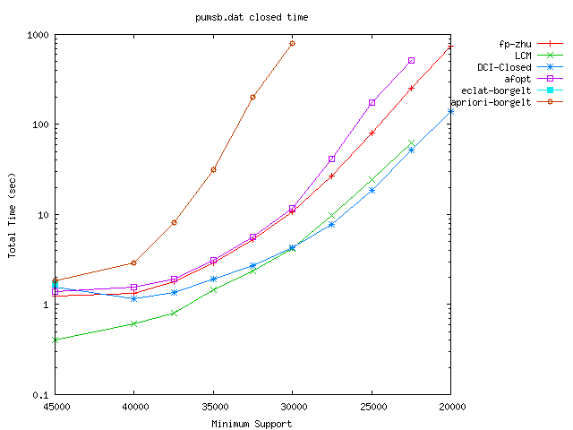
Implementations for Frequent Itemset
・ Frequent itemset is a central topic in data mining, thus has many programs to enumerate
・ Both input and output are often large, scalability is important
・ Algorithm design affects the
performance drastically
・ It is true even in international
competitions (time is log scale)
Let’s see the techniques for speeding up

Slide 30
Transaction Database
A database such that each transaction (record) T is a set of items (subset of itemset E), i.e., ∀T ∈D, T ⊆ E
For set P,
occurrence of P: a transaction of D including P
occurrence set of P (Occ(P)): set of occurrences of P
frequency of P (frq(P)): cardinality of Occ(P)
1,2,5,6,7,9
2,3,4,5
1,2,7,8,9
1,7,9
2,7,9
2
D ＝
Occ({1,2})
＝ { {1,2,5,6,7,9},
{1,2,7,8,9} }
Occ({2,7,9})
＝ { {1,2,5,6,7,9},
{1,2,7,8,9},
{2,7,9} }

Slide 31
Frequent Itemset
frequent itemset: an itemset included in at least σ transactions of D
（a set whose frequency is at least σ）（σ is given, and called minimum support）
Ex) itemsets included in at least 3 transactions in D
1,2,5,6,7,9
2,3,4,5
1,2,7,8,9
1,7,9
2,7,9
2
included in at least 3
{1} {2} {7} {9}
{1,7} {1,9}
{2,7} {2,9} {7,9}
{1,7,9} {2,7,9}
D ＝
Frequent itemset mining is to enumerate all frequent itemsets of the given database and minimum support σ

Slide 32
Backtracking Algorithm
・ Family of frequent itemsets satisfies monotonicity (any subset of a frequent itemset is also frequent)
➔ backtrack algorithm is applicable
Backtrack (P)
1 Output P
2 For each e > tail of P (maximum item in P)
If P∪e is frequent call Backtrack (P∪e)
－ #recursive calls = #frequent itemsets
－a recursive call（iteration）takes time
(n- (tail of P))×(time for frequency counting)
O(|D|)
1,2,3,4
1,2,3
1,2,4
1,3,4
2,3,4
1,2
1,3
1,4
2,3
2,4
3,4
1
2
3
4
O(n|D|) per solution is too long
φ

Slide 33
Shorten “Time for One Solution”
・Time per solution is polynomial, but too long
・ Each P∪e needs to compute its frequency
－Simply, check each transaction includes P∪e or not
➔ worst case: linear time in the database size
average: max{ #transactions, frq(P)×|P| }
－ Constructing efficient index, such as binary tree,
is very difficult, for inclusion relation
1,2,5,6,7,9
2,3,4,5
1,2,7,8,9
1,7,9
2,7,9
2
Algorithm for fast computation is needed

Slide 34
(a) Breadth-first Search
D₀={φ}, k := 1
while D_{k-1} ≠φ
for each P ∈ D_{k-1}
for each e
if P∪e is frequent then insert P∪e to D_{k}
・ Before computing frequency of P∪e,
check whether P∪e＼f is in D_{k}
or not for all f∈P
・ If some are not, P∪e is not frequent
1,2,3,4
1,2,3
1,2,4
1,3,4
2,3,4
1,2
1,3
1,4
2,3
2,4
3,4
1
2
3
4
can prune some infrequent itemsets, but takes much memory and time for search
φ

Slide 35
(b) Using Bit Operations
・ Represent each transaction/itemset by a bit sequence
{1,3,7,8,9} ➔ [101000111]
{1,2,4,7,9} ➔ [110100101]
[100000101]
➔ Intersection can be computed by AND operation
(64 bits can be computed at once!)
Also, memory efficient, if the database is dense
But, incompatible with the database reduction, explained later

Slide 36
(c) Fasten Backtrack
・ Any occurrence of P∪e includes P (→ included in Occ(P))
➔ to find transactions including P∪e , we have
to see only transactions in Occ(P)
・ T∈ Occ(P) is included in Occ(P∪e)
if and only if T includes e
・ By computing Occ(P∪e) from Occ(P),
we do not have to scan the whole database
➔ Computation time is reduced much

Slide 37
Intersection Efficiently
・ T∈ Occ(P) is included in Occ(P∪e) if and only if T includes e
➔ Occ(P∪e) is the intersection of Occ(P) and Occ({e})
・ Taking the intersection of two itemsets can be done by scanning the itemsets simultaneously in the increasing order of items (itemsets have to be sorted)
{1,3,7,8,9}
{1,2,4,7,9}
＝ {1,7,9}
Linear time in #scanned items → sum of their sizes

Slide 38
Using Delivery
・ Taking intersection for all e at once, fast computation is available
１． Set empty bucket for each item
２． For each transaction T in Occ(P),
－ Insert T to the buckets of all item e included in T
➔ After the execution, the bucket of e
becomes Occ(P∪e)
bucket[e] := φ for all e
for each T∈P
for each e∈T, e > tail(P)
insert T to bucket[e]
1: A,C,D
2: A,B,C,E,F
3: B
4: B
5: A,B
6: A
7: A,C,D,E
8: C
9: A,C,D,E
A: 1,2,5,6,7,9
B: 2,3,4,5
C: 1,2,7,8,9
D: 1,7,9
E: 2,7,9
F: 2

Slide 39
Time for Delivery
jump := φ; bucket[e] := φ for all e
for each T∈P
for each e∈T, e > tail(P)
if bucket[e] = φ then insert e to jump
insert T to bucket[e]
end for
end for
・ Comp. time is Σ_{T∈Occ(P)} |{e | e∈T, e > tail(P)}|
・ Computation time is reduced by preparing
the occurrences for all items for the
recursive calls at once, and thus
A: 1,2,5,6,7
B: 2,3,4,5
C: 1,2,7,8,9
D: 1,7,9
E: 2,7,9
F: 2

Slide 40
Occurrence Delivery
・ Compute the denotations of P ∪{i} for all i’s at once,
A | 1 | 2 |  |  | 5 | 6 | 7 |  | 9
B |  | 2 | 3 | 4 | 5
C | 1 | 2 |  |  |  |  | 7 | 8 | 9
D | 1 |  |  |  |  |  | 7 |  | 9
E |  | 2 |  |  |  |  | 7 |  | 9
F |  | 2
A
A
A
A
1,2,5,6,7,9
2,3,4,5
1,2,7,8,9
1,7,9
2,7,9
2
D＝
C
C
C
D
P = {1,7}
Check the frequency for all
items to be added in linear
time of the database size
Generating the recursive calls in reverse
direction, we can re-use the memory

Slide 41
Intuitive Image of Iteration Cost
・ Simple frequency computation scan
The whole data, for each P∪e
・ Set intersection scans Occ(P)
and Occ({e}) once
➔ n-t times scans Occ(P), and
items larger than t of all transactions
・ Delivery scans items larger than t
of transactions included in Occ(P)
(n-t)
Advantage is more
＋
(n-t)
t
t

Slide 42
Bottom-wideness
・ In the deep levels of the recursion, frequency of P is small
➔ Time for delivery is also short
・ Backtrack generates several recursive calls in each iteration
➔ Recursion tree spreads exponentially, as going down
➔ Computation time is dominated by the bottom-level exponentially many iterations
Long time,
but few
Short time, noumerous
・・・
Almost all iterations takes short time
➔ In total, average time per iteration also short

Slide 43
Even for Large Support
・ When σ is large, |Occ(P)| is large in bottom levels
➔ Bottom-wideness doesn’t work
・ Speed up bottom levels by database reduction
（１） delete items smaller than added item at last
（２） delete items infrequent in the database induced by Occ(P)
(they never be added to the solution, in the recursive calls)
（３） unify the identical transactions
・ In real-world data, usually the size of
reduced database is constant
１ |  | ３ | ４ | ５
１ | ２ |  | ４ |  | ６
 |  | ３ | ４ |  |  | ７
１ | ２ |  | ４ |  | ６ | ７
 |  | ３ | ４ | ５ | ６ | ７
 | ２ |  | ４ |  | ６ | ７
fast as much as small σ

Slide 44
Synergy with Cache
・ Efficient implementation needs “hit/miss ratio” of cache
－ open the loops
－ change memory allocation
for i=1 to n { x[i]=0; }
➔ for i=1 to n step 3 { x[i]=0; x[i+1]=0; x[i+2]=0; }
● |  | ● |  |  |  | ●
● | ● | ●
● |  | ● |  |  |  | ●
●▲ |  | ● ▲ |  |  |  | ● ▲
▲ |  | ▲ |  |  |  | ▲
By database reduction, memory for deeper levels fits cache
➔ Bottom-wideness implies “cache hits almost all accesses”

Slide 45
Compression by Trie/Prefix Tree
・ Regarding each transaction as a string, we can use trie / prefix tree to store the transactions, to save memory usage
➔ Orthogonal to delivery, shorten the time to scan
*
1
2
5
6
7
9
A
A: 1,2,5,6,7,9
B: 2,3,4,5
C: 1,2,7,8,9
D: 1,7,9
E: 2,3,7,9
F: 2,7,9
7
8
9
C
7
9
D
21
3
4
5
B
7
9
E
7
9
F

Slide 46
２．２ Result of Competition

Slide 47
Competition: FIMI04
・ FIMI: Frequent Itemset Mining Implementations
－ A satellite workshop of ICDM (International Conference on Data Mining). Competition on implementations for frequnet/closed/maximal frequent itemsets enumeration
FIMI 04 is the second, and the last
・ The first has 15, the second has 8 submissions
Rule and Regulation:
－ Read data file, and output all solutions to a file
－ Time/memory are evaluated by time/memuse command
－ direct CPU operations (such as pipeline control) are forbidden

Slide 48
Environment： FIMI04
・ CPU, memory: Pentium4 3.2GHz、1GB RAM
OS, Language, compiler: Linux, C, gcc
・ dataset:
－ real-world data: sparse, many items
－ machine learning repository: dense, few items, structured
－ synthetic data: sparse, many items, random
－ dense real-world data: very dense, few items
LCM ver.2 (Uno, Arimura, Kiyomi) won the Award

Slide 49
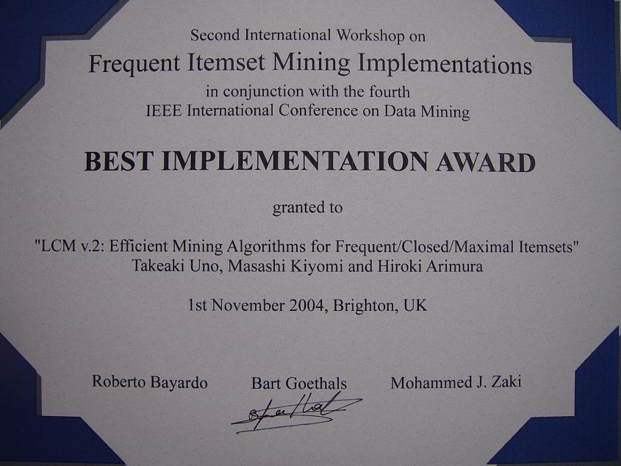
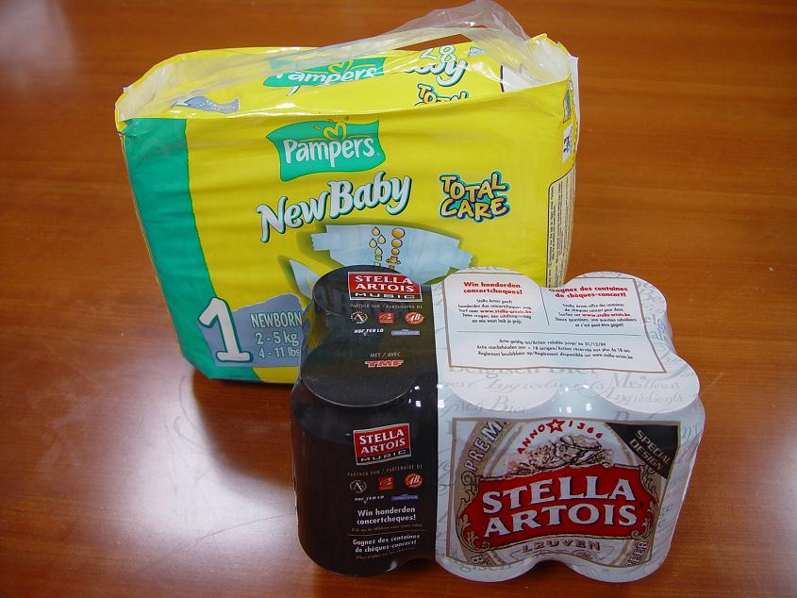
Award and Prize
Prize is {beer, nappy}
the “Most Frequent Itemset”

Slide 50
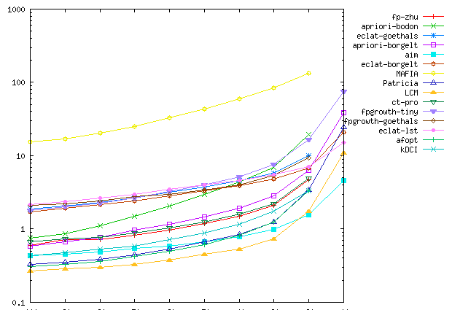
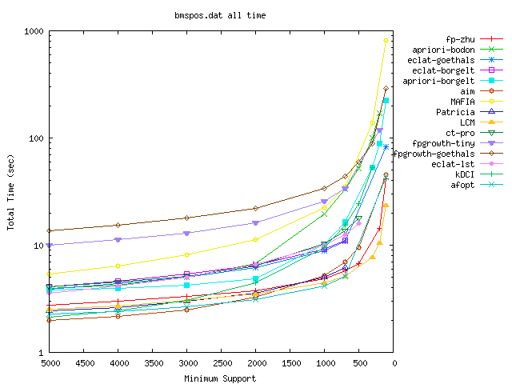
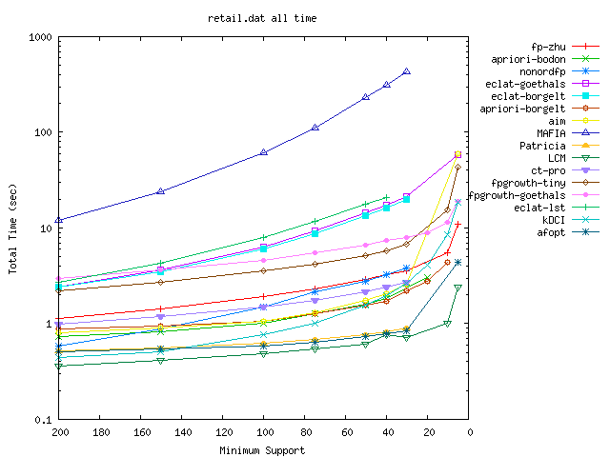
Real-world data (sparse) average size 5-10
BMS-WebView2
BMS-POS
retail

Slide 51
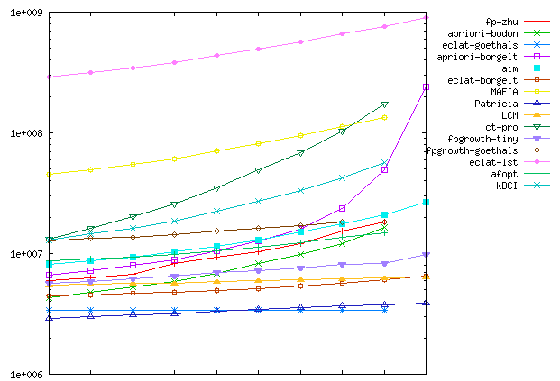
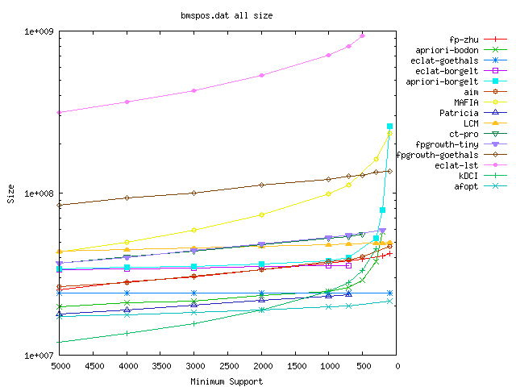
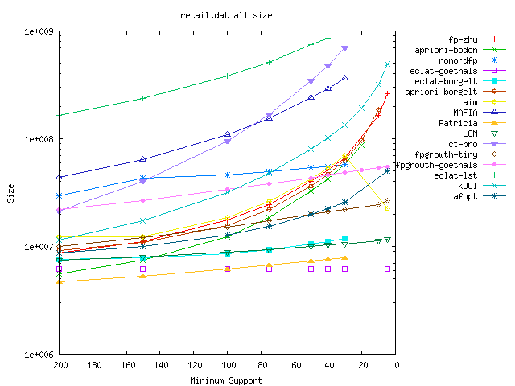
Real-world data(sparse) memory usage
BMS-WebView2
BMS-POS
retail

Slide 52
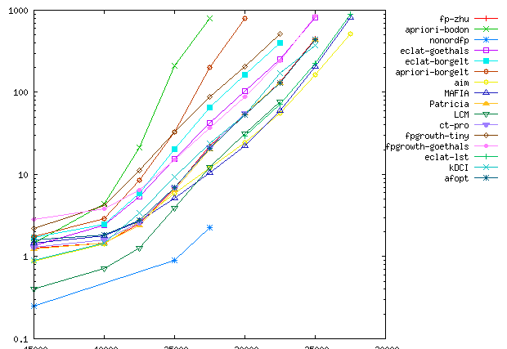
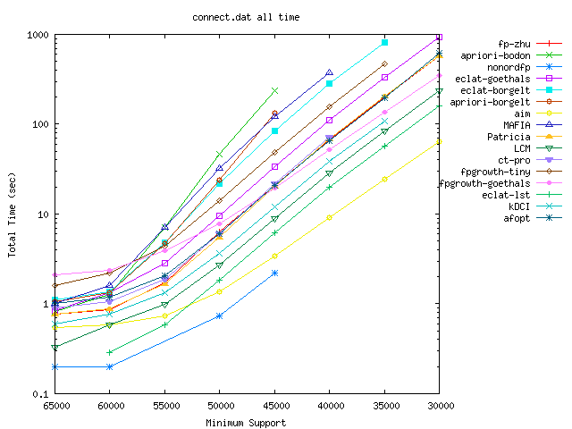
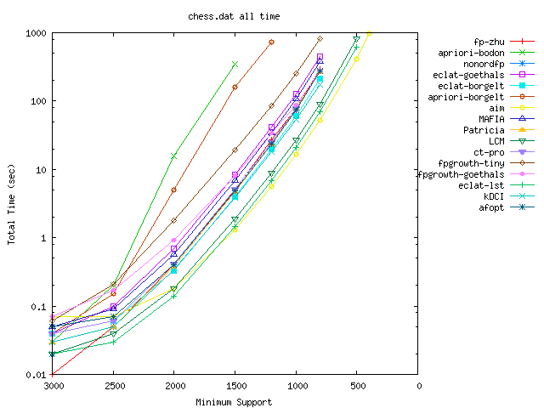
Dense (50%) structured data
pumsb
connect
chess

Slide 53
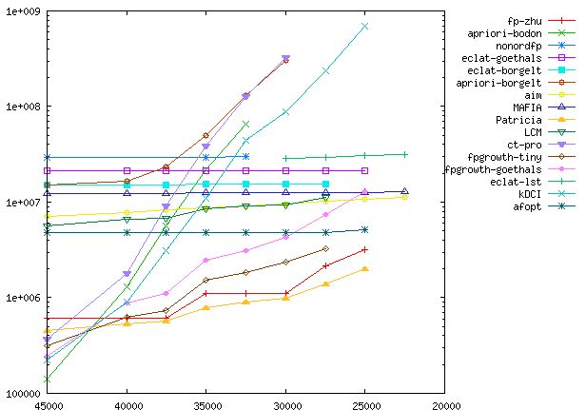
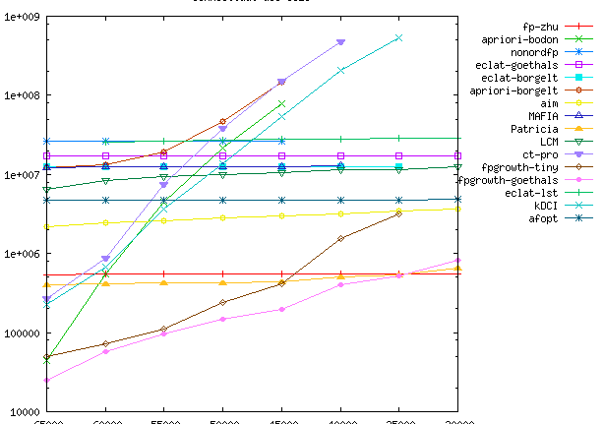
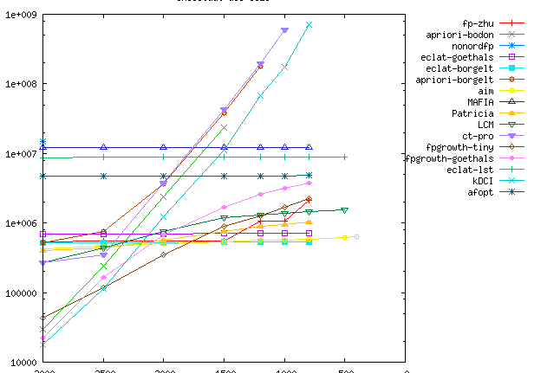
Memory usage: dense structured data
pumsb
connect
chess

Slide 54
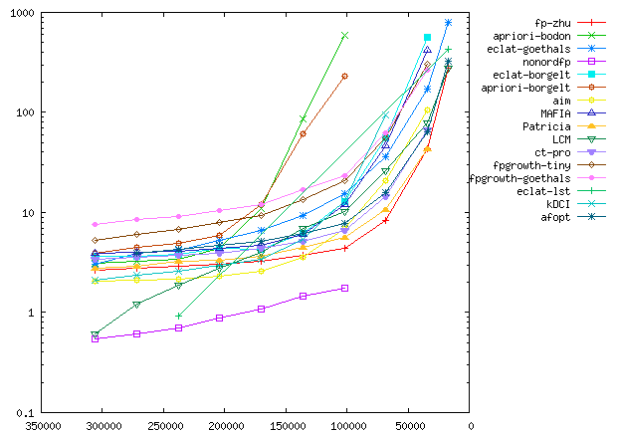
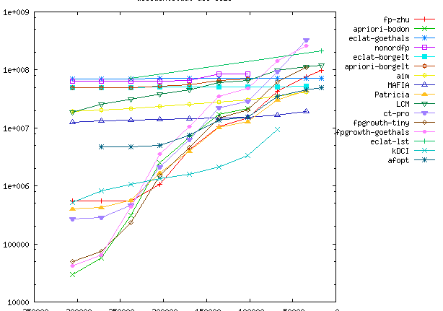
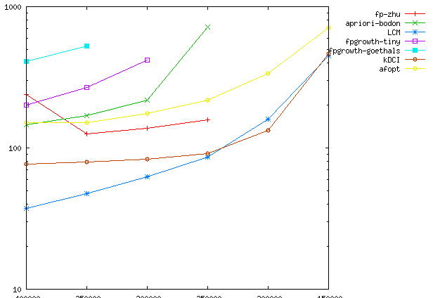
Dense real-world/ Large scale/ data
accidents
accidents メモリ
web-doc

Slide 55
Other Frequent Patterns
・ Bottom-wideness, Delivery and database reduction are availabe for many kinds of other frequent pattern mining
－ string, sequence, time series data
－ matrix
－ geometric data, figure, vector
－ graph, tree, path, cycles…
pattern
XYZ
{A,C,D}
record
AXccYddZf
{A,B,C,D,E}

Slide 56
２．３ Speed-up Spanning Tree Enum.

Slide 57
Connected Component Enumeration
・ For a given graph G and its vertex r, enumerate all vertex subsets including r such that their induced subgraphs are connected
・ Choose a vertex v adjacent to r, and
divide the problem into subproblems
those including v, and not including v
➔ enumerate recursively

Slide 58
Efficient Computation
・ Maintianing the set of vertices adjacent to r fastens the computation
・ In contraction, take union of the
neighbors of r and that of v
➔ Each iteration takes O(#candidates) time

Slide 59
Efficient Computation
・ Each iter. makes 2 recursive calls ➔ #iterations ＜ ２×#solutions
not-use v
O(1)
use v
O(d(r)+d(v))
not use
not use
・・・
・ each iteration delivers its comp. time to all vertices in the left-down path of right child
➔ 各反復に O(1) 時間
➔ 各解に O(1) 時間
not use
at least (d(r)+d(v)) ／2
not use

Slide 60
Spanning Tree Enumeration
・ A spanning tree is a subtree including all the vertices
・ Choose an edge e, and divide the
problem; that including e, and that
not-including e
➔ enumerate recursively

Slide 61
In Deep of Recursion
・ In deep levels, #edges/vertices are decerased
・ On the other hand, selfloops, bridges, multiple edges increase
・ Selfloops never be used, brides are always used, thus can be deleted from the problem
➔ the problem is reduced
➔ computation time is much reduced in the bottom levels

Slide 62
Copying Recursive Call
・ k multiple edges ➔ k (same) problems using one of the edges
・ k pseudo cycle ➔ k (same) problems not-using one of the edges
➔ k identical problems are generated by generating one of them
・ When graph is small, many selfloops/bridges appear, and thus we can make many identical problems in short time

Slide 63
３． Search ３．１ Divide-and-Conquer

Slide 64
Enumeration of Feasible Solutions
・ Feasible solution to a formula is an assignment that satisfies all the clauses
（x₁∨x₂∨￢x₃） ∧ （￢x₁∨x₂∨x₄）∧・・・∧（￢x₅∨x₄）
・ Finding a feasible solution is NP-complete
➔ Enumeration is also hard
・ If we want to enumerate even though,…
➔ generally, use divide and conquer + pruning

Slide 65
Divide and Conquer
・ Determine the value of variables one by one
・ Recursive call for each value
・ At the bottom of recursion,
an assignment is determined
・ Prune the brunch when we
confirm non-existence of
solution in descendants
⬅ accuracy and speed
are the key.
Exact ∩ polytime,
then polytime delay
v₁
￢v₁
v_{1,} v₂
v_{1,} ￢v₂
￢v_{1,} v₂
￢v_{1,} ￢v₂

Slide 66
Pruning (bounding)
・ No feasible solution exists in the descendants
➔ impossible to satisfy all clauses (un-satisfied clause)
（x₁∨x₂∨￢x₃） ∧ （￢x₁∨x₂∨x₄）∧・・・∧（￢x₅∨x₄）
（x₁∨x₂∨￢x₃） ∧ （￢x₁∨x₂∨false）∧・・・∧（￢true∨false）
・ Find a feasible solution in the middle of recursion
➔ partial assignment satisfies the formula
・ Satisfiability is usually easy to check, on average, thus possibly fast in practice

Slide 67
Monotone Set Family
・ Set family is a set of subsets of a ground set
・ F satisfies monotone property if any subset of its member is also a member
－ frequent itemsets, cliques, forests, graphs, hitting sets, …
・ Members of monotone set family is easy by backtrack algorithm, but maximal members are difficult to enumerate
⬅ maximal member is a member included in no other member

Slide 68
Shift A Solution to the End
・ Maximal enumeration admits a simple pruning algorithm
① prune if meets a non-member
② no brunch needed if addition of all remaining members is a member
・ Even if ① is complete, exhaust search for all members is inefficient
・ Find a maximal solution, shift all its element to the bottom, then no need of recursive calls for the shifted elements
➔ because ② works for the elements!
element ordering
For small maximal (up to 30), practically efficient

Slide 69
Pseudo Code
・ Describe the algorithm by a pseudo code
(Implement “do not use XX” by for loop, but not a recursive call)
EnumMax (P:current solution, I: undetermined elements)
find S that is maximal among those including P and included in P∪I
if S is a maximal solution of the problem output S
for each e∈I＼S
I := I＼{e} ; call EnumMax（P∪e, I）
element ordering
P
I

Slide 70
３．２ Closed Itemset Enumeration

Slide 71
Disadvantage of Frequent Itemset
・ To find interesting(deep) frequent itemsets, we need to set σ small
➔ numerous solutions will appear
・ Without loss of information, we want to shift the problem (model)
１． maximal frequent itemsets
included in no other frequent itemsets
２． closed itemsets
maximal among those
having same occurrence set
111…1
000…0

Slide 72
Ex) maximal frequent / closed itemsets
・ Classify frequent itemsets by their occurrence sets
included in at least 3
{1} {2} {7} {9}
{1,7} {1,9}
{2,7} {2,9} {7,9}
{1,7,9} {2,7,9}
1,2,5,6,7,9
2,3,4,5
1,2,7,8,9
1,7,9
2,7,9
2
D＝
frequent closed
maximal frequent
closed itemset is the intersection of its occurrences

Slide 73
Advantage and Disadvantage
maximal
・ existence of output polynomial time algorithm is open
・ fast computation is available by pruning like maximal cliques
・ few solutions but sensitive against the change of σ
closed
・ polynomial time enumeratable by reverse search
・ discrete algorithms and bottom-wideness fasten computation
・ no loss w.r.t occurrence sets
・ no advantage for noisy data (no decrease of solution)
Both can be enumerated O(1) time on average, 10k-100k / sec.

Slide 74
Bipartite Graph Representation
・ Items and transactions are vertices, and the inclusion relations are the edges
A: 1,2,5,6,7,9
B: 2,3,4,5
C: 1,2,7,8,9
D: 1,7,9
E: 2,7,9
F: 2
1 2 3 4 5 6 7 8 9
A B C D E F
D＝
・ itemset and transactions including it
➔ bipartite clique of the graph
・ itemset and its occurrence set
➔ bipartite clique maximal on the transaction side
・ closed itemset and its occurrence set ➔ maximal bipartite clique

Slide 75
From Adjacency Matrix
・ See the adjacency matrix of the bipartite graph
A: 1,2,5,6,7,9
B: 2,3,4,5
C: 1,2,7,8,9
D: 1,7,9
E: 2,7,9
F: 2
 | 1 | 2 | 3 | 4 | 5 | 6 | 7 | 8 | 9
A | 1 | 1 |  |  | 1 | 1 | 1 |  | 1
B |  | 1 | 1 | 1 | 1
C | 1 | 1 |  |  |  |  | 1 | 1 | 1
D | 1 |  |  |  |  |  | 1 |  | 1
E |  | 1 |  |  |  |  | 1 |  | 1
F |  | 1
D＝
・ itemset and transactions including it
➔ a submatrix all whose cells are 1

Slide 76
Methods for Closed Itemset Enumeration
・ Based on frequent itemset enumeration
－ enumerate frequent itemsets, and output only closed ones
－ can not get advantage of fewness of closed itemsets
・ Storage ＋ Pruning
－ store all solutions found, and use them for pruning
－ pretty fast
－ memory usage is a bottle neck
・ reverse search ＋ database reduction （LCM）
－ computation is efficient
－ no memory for previously found solutions

Slide 77
Neighbor Relation of Closed Itemsets
・ Remove items from closed itemset, in decreasing ordering
・ At some point, occurrence set expands
・ Compute the closed itemset of the expanded occurrence set
・ The obtained closed itemset is the parent (uniquely defined)
・ Frequency of the parent is always larger than the child, thus the parent-child relation is surely acyclic
➔ The parent-child relation induces a directed spanning tree

Slide 78
Reverse Search
Parent-child relation induces a directed spanning tree
DFS search on the tree can find all solutions
・ Enumeration method for all children of a parent is enough to search
・ If children are found polynomial time on average, output polynomial
(child is obtained by adding an item to the parent)
Acyclic relation and polytime children enumeration are sufficient to polytime enumeration of any kind of objects

Slide 79
Ex) Parent-child Relation
・ All closed itemsets of the following database, and the parent-child relation
φ
2
1,2,5,6,7,9
2,3,4,5
1,2,7,8,9
1,7,9
2,7,9
2
7,9
1,7,9
D ＝
2,5
2,7,9
1,2,7,9
2,3,4,5
Move by adding an item
Parent-child
(ppc extension)
1,2,7,8,9
1,2,5,6,7,9

Slide 80
Computing the Children
・ Let e be the item removed at last to obtain the parent
By adding e to the parent, its occurrence set will be the occurrence set of the child
➔ a child is obtained by adding an item and computing the closed itemset
➔ however, itemsets obtained in this way are not always children
➔ necessary and sufficient condition to be a child is
“no item appears preceding to e” by closure opeartion
(prefix preserving closure extension)

Slide 81
Database Reduction
・ We want to reduce the database as frequent itemset enumeration
・ However, can not remove smaller items (than last added item e)
⬅ computation of ppc extension needs them
・ However,
－ if larger items are identical, included in Occ at the same time
－ so, only the intersection of the smaller parts is needed
store the intersection of transactions having the same large items
・ The intersection of many transactions
has a small size
１ |  | ３ | ４ | ５
１ | ２ |  | ４ |  | ６
 |  | ３ | ４ |  |  | ７
１ | ２ |  | ４ |  | ６ | ７
 |  | ３ | ４ | ５ | ６ | ７
 | ２ |  | ４ |  | ６ | ７
no much loss compared with large σ

Slide 82
Cost for Comparison
・ We can simply compute the intersection of Occ(P∪e), but would be redundant. We do just “checking the equality of the intersection Occ(P∪e) and P”, thus no need to scan all
⬅ We can stop when we confirmed that they are different
・ Trace each occurrence of P∪e in the
increasing order, and check each item
appears all occurrences or not
・ If an item appears in all, check
whether it is included in P or not
・ Proceed the operations from
the last operated item
P
4
11
3
4
6
9
3
4
6
9
11
1
3
4
5
9
11
1
3
4
5
9
Occ(P∪e)
2
3
4
4
5
5
9
9
11
1
1
2
2
4
4
6
6
9
9
11
1
1
4
4
9
9
11

Slide 83
Using Bit Matrix
・ Sweep pointer is a technique for sparse style data.
We can do better if we have adjacency matrix
・But, adjacency matrix is so huge (even for construction)
・ Use adjacency matrix when the occurrence set becomes sufficiently small
➔ By representing the matrix by bitmap, each column (corresponding to an item) fits one variable!

Slide 84
O(1) Time Computation of Bit Matrix
・ By storing the occurrences including each item by a variable, we can check whether all occurrence of P∪e includes an item or not in O(1) time
・ Take the intersection of bit patterns of item i and Occ({e})
・ If i is included in all occurrences of P∪e, the intersection is equal to Occ({e})
Occ(P)
・・・
Occ({e})

Slide 85
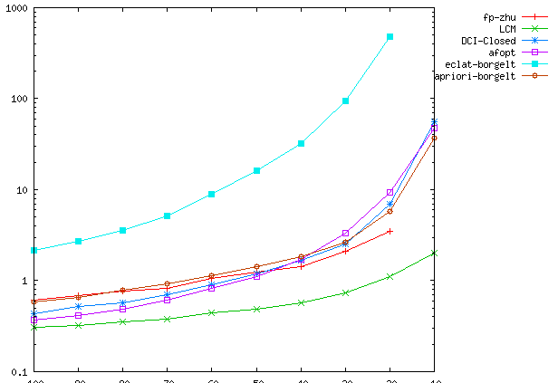
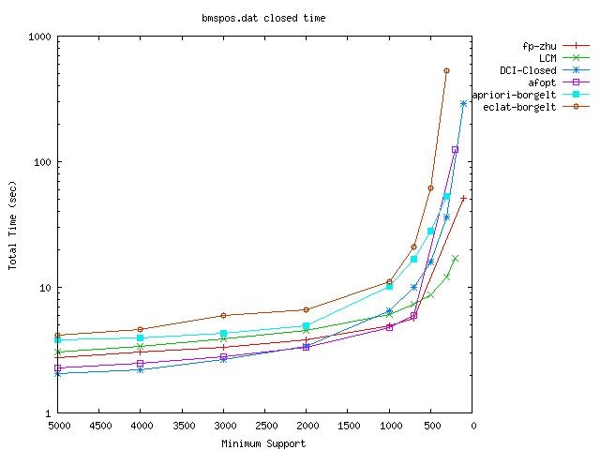
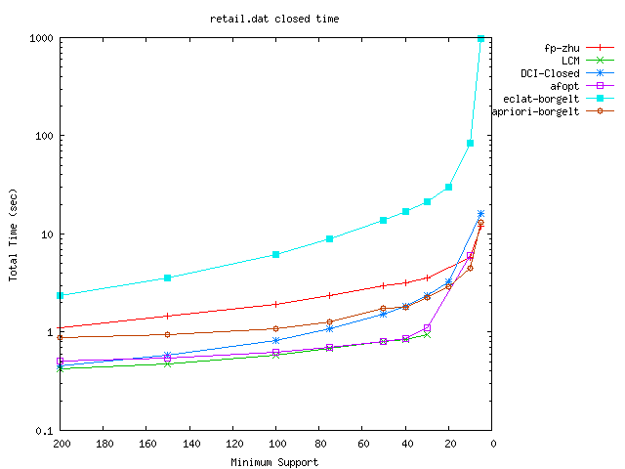
real-world data (sparse) average size 5-10
BMS-WebView2
BMS-POS
retail

Slide 86
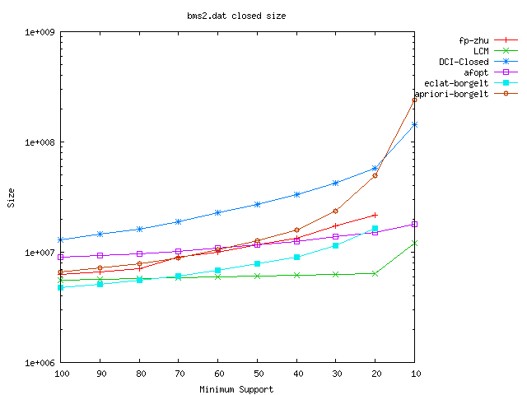
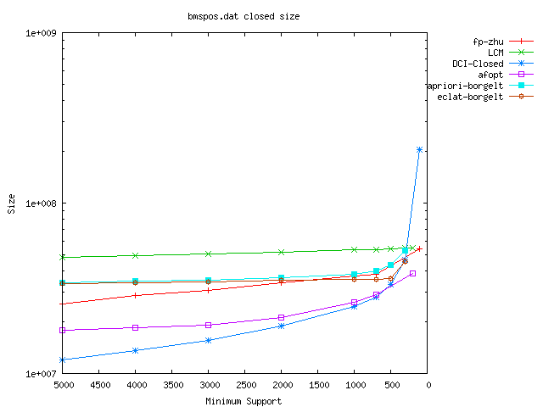
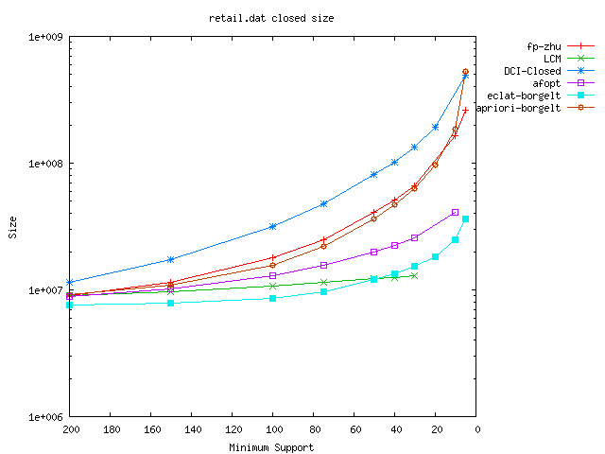
real-world data (sparse) memory usage
BMS-WebView2
BMS-POS
retail

Slide 87
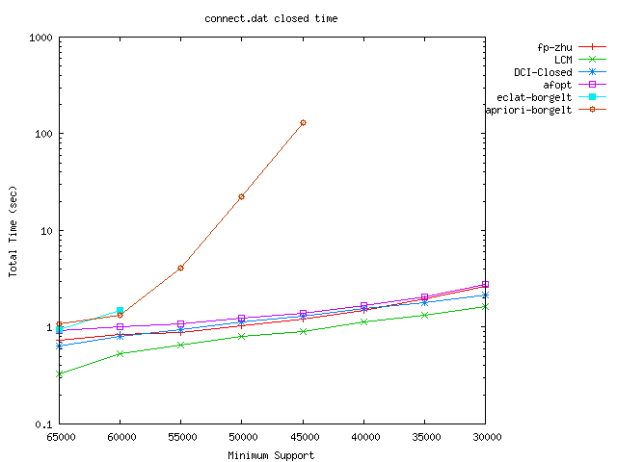
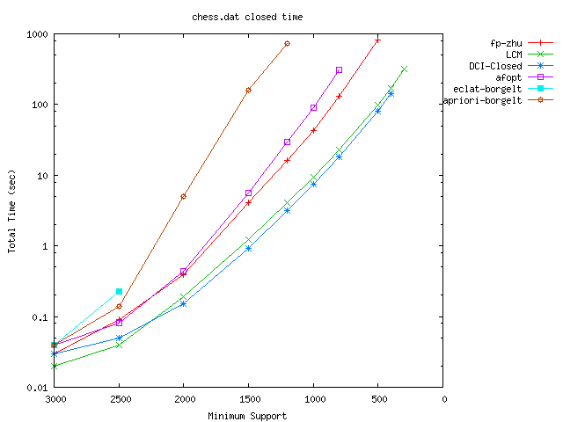
dense (50%) structured data
pumsb
connect
chess

Slide 88
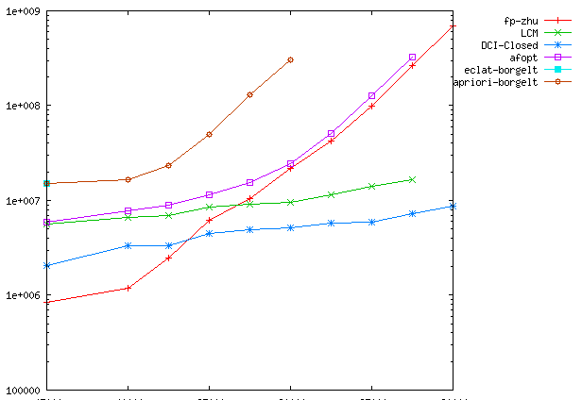
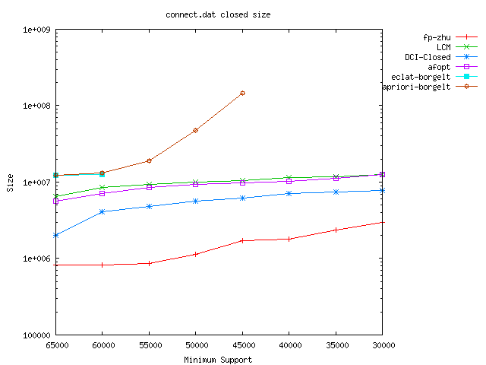
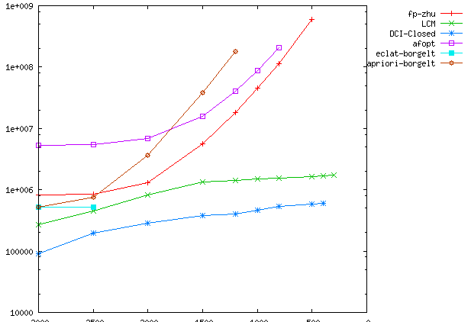
dense structured data, memory usage
pumsb
connect
chess

Slide 89
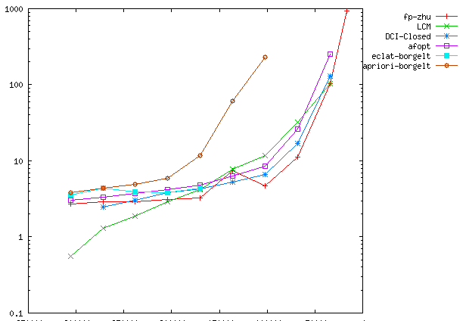
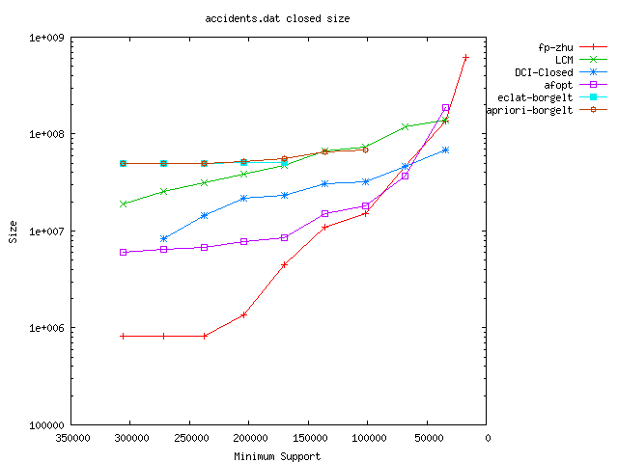
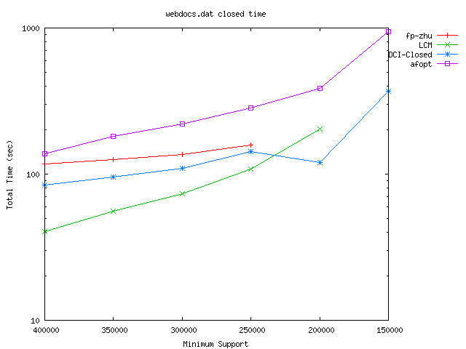
dense real data large scale data
accidents
accidents memory
web-doc

Slide 90
３．３． Maximal Clique Enumeration

Slide 91
Clique Enumeration Problem
Clique of a graph: a subgraph in which all vertices are connected
・ Bipartite clique enumeration can be converted to clique enumeration
・ Maximum clique problem is NP-complete
・ Maximal clique can be obtained easily, and in short time
・ Many studies in optimization, mining, bio-informatics…
・ Many applications for large-scale sparse data such as clustering

Slide 92
Monotonicity of the Cliques
・ Any subset of a clique is also a clique
➔ Satisfies the (anti) monotone property
➔ Start from the emptyset, and add vertices one-by-one.
When current vertex set is not a clique, backtrack, and go up the other direction.
・ Check whether clique or not
is done in O(n²) time, go up to
at most n directions
➔ O(n³) time per clique
111…1
clique
000…0
1,2,3,4
1,2,3
1,2,4
1,3,4
2,3,4
1,2
1,3
1,4
2,3
2,4
3,4
1
2
3
4
Not efficient for large scale data
φ

Slide 93
Squeeze the Candidates
・ Want to efficiently find vertices to add
addible ⬄ adjacent to all vertices of the clique
good to maintain the addible vertices
・ When we add a vertex v to the clique
Still being a candidate ⬄ adjacent to v
候補の集合の更新は、追加する頂点に
隣接する頂点と、候補の共通部分をとればいい
候補
隣接頂点
隣接頂点
クリーク一個あたり、頂点の次数の時間

Slide 94
Bottom-wideness
・ In the deep levels of the recursion, frequency of P is small
➔ Time for delivery is also short
・ Backtrack generates several recursive calls in each iteration
➔ Recursion tree spreads exponentially, as going down
➔ Computation time is dominated by the bottom-level exponentially many iterations
Long time,
but few
Short time, noumerous
・・・
Almost all iterations takes short time
➔ In total, average time per iteration also short

Slide 95
Huge Number of Cliques
・ There are often large clique in real-world data
・ Any subset of a clique is also a clique, thus there are huge number of cliques
・ Thus, we want to maximal cliques
－ #solutions becomes 1/10～1/1000
－ no loss of information,
since any clique is included in a maximal clique
－ maximal cliques may make no un-complete groups
thus a good model
Clique
The key is how to enumerate only maximal cliques

Slide 96
Difficulty of Search
・ maximal clique corresponds to a top of the mountains
➔ can not move to other top by a simple operation
・ To begin with, there is no maximal clique near by the empty set
➔ Backtrack doesn’t work
But, there is an efficient pruning method
(If we could confirm that there are only cliques included properly in some maximal cliques, we prune the brunch)
111…1
Cliques
000…0
We here show polynomial time reverse search algorithm

Slide 97
Adjacency between Maximal Cliques
・ C(K): lexicographically minimum clique including K
(clique obtained by adding smallest vertices repeatedly)
・ Remove vertices in decreasing order from maximal clique K
・ At some point, C(K’) (K’=current clique) becomes not equal to K
・ We define the parent of K by K’ (uniquely defined)
(almost equal to ppc extension, but prefix isn’t preserved)
・ The parent is always lexicographically smaller than its child
➔ Parent-child relation is acyclic, and induces a directed spanning tree

Slide 98
Reverse Search
Parent-child relation induces a directed spanning tree
DFS search on the tree can find all solutions
・ Enumeration method for all children of a parent is enough to search
・ If children are found polynomial time on average, output polynomial
(child is obtained by adding an item to the parent)
Acyclic relation and polytime children enumeration are sufficient to polytime enumeration of any kind of objects

Slide 99
Characterization of Children
・ K[i]： C(K’) where K’ is obtained by adding i to K, and remove all vertices not adjacent to i
・ K‘ is a child of K ➔ K[i] = K’ holds for some i
i
Key to polytime!
Checking all K[i] is enough (at most |V|)
・ if i is adjacent to no vertex of K, the parent of
K[i] is C({i})
Generally, those to be deleted are not unique
Check only vertices adjacent to a vertex in K (at most（Δ+1）²)

Slide 100
Ex) Parent-Child of Maximal Cliques
・The right figure is the parent-child relation of
the maximal cliques in the left graph
１, ２
３
４
１
２
１, ３, ５
２, ４, ６, ８
３
５
４
６
７
10
７
11
９
８
11
10
３, ５, ７, ９, 12
６, ８, 10
４, ８, 11
12
11
11
12
９, 11
８, 10, 11
10, 12

Slide 101
Ex) Parent-Child of Maximal Cliques
・The right figure is the parent-child relation of
the maximal cliques in the left graph
１, ２
３
４
１
２
１, ３, ５
２, ４, ６, ８
３
５
４
６
７
10
７
11
９
８
11
10
３, ５, ７, ９, 12
６, ８, 10
４, ８, 11
12
11
11
12
９, 11
８, 10, 11
10, 12

Slide 102
Computing C(K) from K
・ CAND(K)：set of vertices adjacent to all vertices in vertex set K
・ Repeat, add the minimum vertex in CAND(K)
to K, until CAND(K) will be emptyset
・ CAND(K∪i) ＝ CAND(K) ∩ （vertices adjacent to i）
thus, computed in time linear in degree of i
・ Clique size is at most Δ＋１, thus #repetitions is at most Δ＋１
C(K) can be computed in O(Δ²) time

Slide 103
Computing Parent
・ For all vertices v adjacent some vertices in K, let r(v) be #vertices in K adjacent to v
➔ r(v) = |K| ⇒ addible to K
・ Remove vertices from K in decreasing order,
with updating r(v) (O(Δ²) time)
➔ When r(v) = |K| holds for a vertex v smaller
than last removed vertex, stop
・ Then, compute the lexicographically minimum clique including the current clique
The parent of K can be computed in O(Δ²) time

Slide 104
Time for Finding Children
We have to check vertices adjacent to K (at most(Δ+1)² )
The parent of K can be computed in O(Δ²) time
・ Thus, all children can be found in O(Δ⁴) time
・ An iteration always outputs a solution, and takes O(Δ⁴) time
Maximal Cliques can be enumerated in O(Δ⁴) time per maximal clique, where Δ is the maximum degree

Slide 105
Computation Time
・ Usually, there are not so many maximal cliques
in sparse large scale graphs
(roughly, 10 to 100 times larger than #vertices)
Social network data: 40k vertices, 60k edges ➔ 3 sec.
Dictionary data: 40k vertices, 100k edges ➔ 50 sec.
Web link data: 5M vertices 50M edges ➔ 1 hour ?
…
In real-world sparse data, we can consider that
maximal cliques can be enumerated in practically short time

Slide 106
４．Enumerating non-many solutions

Slide 107
解の数が少なくても
・ 通常、列挙問題として考えられる問題は、
解が組合せ的で、最悪で指数個 存在する
・ そのような列挙問題で重要だったのは、解の数に対する計算時間。１つ見つけるのに、平均どれくらいの時間がかかるか
・ この概念は、解の数がそれほど多くない問題でも重要
・ 出力が組合せ的でない例をいくつか見てみよう

Slide 108
４．１． Enumeration in Computational Geometry

Slide 109
計算幾何学
・ computational geometry のこと。（計算機科学ではない）
・ 幾何学的なデータをどのように扱い、問題をどのように解くかを探求する分野
・ 幾何学的な構造を出力するときは、単なる数値を出すだけではないことが多く、そうなると出力の大きさは O(1) ではない
・ 凸包構成問題と線分交差判定問題を紹介する

Slide 110
凸包
・ 平面上（一般には d 次元空間上）にある点集合を含む最小の凸多角形（多面体）を見つける問題
・ 計算幾何学の３大基礎問題のような位置づけ
・ 出力の大きさは多角形の辺の数なので、最大 n
・ O(n log n) 時間で解ける。ソートが帰着できるので、これは最適

Slide 111
余談：一般次元だと
・ ３次元以上だと、面を出力する問題。面の数は O(n^{d/2}) だそうです。
・ 幾何変換をすると、面で与えられた多面体の端点を出力する問題になる
(a₁,…,a_{d}) => a₁x₁,…,a_{d}x_{d} = c

Slide 112
行進法
・ y軸方向に一番下にある点を見つける。タイがあるときは、一番右のものを選ぶ
・ そこからラップを包むように凸包の辺を見つける
・ 計算時間は、辺を見つける時間 × 辺の数
・ 出力の大きさに線形のアルゴリズム

Slide 113
次の辺を見つけるには
・ 現在の頂点から、各頂点へのベクトルを求める
・ 時計回り順で一番最後になるベクトルが、次の辺
・ 計算時間は O(n)。最適ではないが、出力数依存
・ 実際、ランダムな点配置では、辺の数は O(log n) 程度だそうだ
辺を１つずつ見つけるところが、出力数依存にきいている

Slide 114
線分交差判定問題
・ 平面上（一般には d 次元空間上）にある線分の集合に対して、どの線分の組が交差するか調べる問題
・ 出力は辺の組なので、最大 n²。最悪、全部が交差する。
・ ２つの線分の交差判定は O(1) 時間でできる
・ 単純に全ての組を比較するアルゴリズムは、入力の大きさの意味では最適なアルゴリズム
・ 出力数依存のアルゴリズムが作れるか？

Slide 115
スイープ法
・ 垂直な走査線を一番左から一番右へと移動し、途中にある交点を１つずつ見つける
・ ① 線分の始まり ② 線分の終わり ③ 交点
をイベント点として、イベント点をたどってスキャンする
・ 次に来そうなイベント点を、x 座標をキーにしてヒープに突っ込み、小さいものから順に取り出す

Slide 116
スイープ法
・ 走査線上で隣り合う線分のみ、交点があるかどうか調べる
⬅ 交わる２つの線分は、交点直前のイベント点で必ず隣接する
ので、これだけで全部見つけられる
・ 時間は （イベント点数）×（ヒープ操作時間） ＝ O((n+K)log n)
➔ 交点の数 K に対して線形時間
隣り合うものだけを見ることで、全部見ないですむ

Slide 117
他にも
－ 文字列マッチング （部分文字列としてマッチするところを見つける）
－ 時系列データの中から、要素の平均が大きな区間を見つける問題
－ 平面上に与えられた頂点集合を含む、何らかの条件を満たす極小な四角を見つける問題

Slide 118
４．２ Find Similar Pairs of Records

Slide 119
類似項目の発見
・ 工学的な基礎的な問題でも、解の少ない列挙問題はある
・ データベースの項目の中で、似た項目のペアを全て見つける（項目のペア全てについて、
2項関係が成り立つかを調べる）
・ 類似している項目の検出は、
データベース解析の基礎的な手法
➔ 基礎的なツールがあれば、使い方しだいで
いろいろなことができる
（大域的な類似性、データの局所的な関連の構造・・・）

Slide 120
類似項目発見の計算時間
・ 似たもののペアを全て見つけるさい、項目のペア全てについて、単純に全対比較を行うと項目数の２乗の時間がかかる
➔ 項目数が100万を越えるころか現実的には解けなくなる
100万×100万 ÷100万（演算per秒） = 100万秒
・ 類似検索を使う手もあるが、100万回のクエリを実行しなければならない。類似検索は完全一致より大幅に時間がかかる
➔ 1秒間にクエリが1000回できるとして、1000秒
問題が大きいので、平均的な意味でよいので、
計算オーダーの小さいアルゴリズムがほしい

Slide 121
応用１：リンクが似ているwebページ
・ リンク先、あるいはリンク元が、集合として似ているページは、よく似ていると考えられる
⬅ サッカーのページ、料理のページ、地域のページ
・ グループ化すれば、コミュニティー発見、著名なトピック、web の構造の解析など、いろいろなことがやりやすくなる
・ さらに、例えば、「スパムサイト」の検出にも使えるかも
（レポート課題のコピーの検出、とか）

Slide 122
応用３：長い文章の比較
・ （文庫本のような）長い文章がいくつかあるときに、類似する部分がどことどこにあるかを検出したい
➔ 長い文章の比較はそれ自体が大変（時間がかかる）ので、複数あると手が出ない
・ 長い文章を、短い文字列にスライスし、全体を比較する
➔ 大域的に似た部分は、局所的に似ている
ところを多く含むと思われる
つまり、似ている短い文字列のペアを多く含む
・ 短い文字列の全対比較からアプローチできる

Slide 123
応用５： 特異的な部分を見つける
・ 似ているものがない項目は、データの中で特異的な部分と考えられる
－ 携帯電話・クレジットカードの不正使用
－ 制御システムの故障・異常の発見
－ 実験データから新しいものを発見
－ マーカーの設計 （「宇野毅明のホームページは、”助教授，宇野毅明の研究”で検索するとユニークに定まる）
・ 比較的大きなデータが複数あるような場合でも、特異な項目を多く含むもの、他のどのデータとも、似ている部分が少ないものは、特異なデータだと考えられる
・ 「似ている項目の数」は、データがエラーを含む際の統計量として使えるかも知れない

Slide 124
Similar Short String Pair Enumeration
Problem: For given a set S of strings of fixed length l, find all pairs of short strings such that their Hamming distance is at most d.
・ To compare long string, we set S to (all) short substrings of length l, solve the problem, and get similar non-short substrings
・ Also applicable to local similarity detection, such as assembling and mapping
ATGCCGCG
GCGTGTAC
GCCTCTAT
TGCGTTTC
TGTAATGA
．．．
・ ATGCCGCG & AAGCCGCC
・ GCCTCTAT & GCTTCTAA
・ TGTAATGA & GGTAATGG
．．．

Slide 125
Visualization by Dot Plot
・ The idea of visualization is quite simple
・ Put two strings in X-direction and Y-direction, and write a dot when the corresponding part is similar
➔ similar long strings are
drawn by diagonal lines
・ However, we may have noise
when there are huge amount of
small similar structures
string A
String B
Erasing unnecessary similar
structures is crucial

Slide 126
Summary: Difficulty and Approach
・ Definition of local similarity, from local structures, and ambiguity
➔ enumerational approach: find similar short substrings
・ Grasp non-short similar substructures
➔ visualization by dot plot
・ Finding all small similar structure is computationally hard
➔ we propose a quite efficient algorithm
・ Noise will hide everything when the string length is huge
➔ we propose a filtering method according to a necessary
condition for non-short similarity

Slide 127
Difficulty by Complexity
・ If all the strings are the same, the output size is O(|S|²)
➔ for fixed constant l,
straightforward pairwise comparison is optimal
➔ trivial problem in the sense of time complexity
・ However, in practice, comparisons of such data are unnecessary
(we would approach in the other way, such as clustering)
➔ we assume here “output is small”
ATGCCGCG
GCGTGTAC
GCCTCTAT
TGCGTTTC
TGTAATGA
．．．
・ ATGCCGCG & AAGCCGCC
・ GCCTCTAT & GCTTCTAA
・ TGTAATGA & GGTAATGG
．．．

Slide 128
Existing Approach
・ Actually, this is a new problem but…
Similarity search
・ Construct a data structure to find substrings similar to query string
➔ difficult to make fast and complete method
➔ so many queries of not short time
Homology search algorithms for genomic strings, such as BLAST
・ Find small exact matches (same substring pair of 11 letters), and extend the substrings as possible unless the string pair is not similar
➔ we find so many exact matches
➔ increase the length “11” decreases the accuracy
➔ Usually, ignore the frequently appearing strings

Slide 129
Observation: Block Match
・ Consider partition of each string into k（>d）blocks
➔ If two strings are similar, they share at least k-d same blocks
➔ for each string, candidates of similar strings are those having
at least k-d same blocks
・ However, finding candidates by database search is not an easy task, thus we use another way;
we classify the strings according to the blocks

Slide 130
Multi-classification Algorithm
・ We choose one combination of k-d blocks,
and, classify the strings to groups having the same blocks
・ Then, pairwise comparison in each group
➔ The case that the same blocks are these positions is done
・ We do this for all combinations of k-d blocks, so that all similar string pairs will be surely found

Slide 131
An Example
・ Find all pairs of Hamming distance at most 1, from ABC、ABD、ACC、EFG、FFG、AFG、GAB
ABCDE
ABDDE
ADCDE
CDEFG
CDEFF
CDEGG
AAGAB
A BCDE
A BDDE
A DCDE
C DEFG
C DEFF
C DEGG
A AGAB
A BC DE
A BD DE
A DC DE
C DE FG
C DE FF
C DE GG
A AG AB
ABC DE
ABD DE
ADC DE
CDE FG
CDE FF
CDE GG
AAG AB

Slide 132
Avoiding Duplications
・ If more than k-d blocks are the same, the string pair output more than once
➔ avoiding duplication is necessary
・ Define the canonical k-d blocks by the leftmost one
・ Do not output, if the string pair found has an un-considered same block, which is left to the rightmost block of the current operating k-d blocks
Avoid duplication without using memory

Slide 133
Computation Time
・ The classification is done by a radix sort, or simply bucket sort,
in O(l |S|) time
・ By recursively classify the blocks one-by-one to sharing the classification of the same position of blocks, reduces to O((l/k) |S|)
・ Time for classification is O((l/k) |S| _{k}C_{d}) in total
・ Time for pairwise comparison depends on the group size
➔ we choose a good k before execution of the algorithm
・ When k=l, any pair in a group is similar
➔ The time complexity is O((|S| + dN) _{k}C_{d})

Slide 134
An Image for Getting Intuition
・ The problem of similar pairs of records (strings) can be considered as finding cells of a matrix of a certain kinds
・ Pairwise comparison looks at all the cells
・ Multi-classification recursively find small areas in which candidates of similar records
are, like a tree search

Slide 135
Why Fast?
・Figure out the cells to be checked
・The size of the areas accessed differ very much
・Be faster when there are more groups
× _{k}C_{d}

Slide 136
Exp: fix length to 20, and change distance d
Prefixes of Y-chromosome of Human, on a note PC with Pentium M
1.1GHz, 256MB RAM

Slide 137
Exp.: fix length to 30, and change distance d
Web texts writen in Japanese, Core2duo, E8400 3GHz, 4GB RAM

Slide 138
Visualization by Dot Plot
・ To capture the global similarity, visualize it by drawing a figure
・ Consider a matrix, whose cell corresponds to pair of (long) substrings of two strings
・ Intensity of a cell is given by
the number of similar substrings
taken from the corresponding
(long) substrings
⬅ Strings taken from all positions
・ Long similar substrings
will be seen as diagonal lines
string A
String B

Slide 139
Dot Plot of Genome Comparison
・ Compare two genome strings taken from mouse genome of a “complicated part”
・ Their lengths are about 100,000, we set l=30 and d=2
・ From the result we
can see the similarity structure
・ ”white” → possibly similar,
“black” → never similar
genome A
genome B
1 sec. by usual PC

Slide 140
Dot Plot for Long Genome Sequence
・ The comparison of mouse 11th chromosome and human 17th chromosome is …
not visible
・ Huge amount of noisy
similar pairs hide everything
・ By restricting #output
pairs to 10, for each string,
we can see something
➔ Still noisy, and lose
completeness
Mouse 11th chr.
Human 17th chr
2 min by PC

Slide 141
Same Intensity
・ Even if a cell includes many pairs, it does not always represent the similarity
・ Pairs composing diagonal a line are important
➔ Pairs distributed are not
➔ Pairs concentrated into a small area are also not
・There would be many models representing “pairs on a line”,
but we use a simple one

Slide 142
Box Filtering
・ One of simple models is to consider the number of pairs in a diagonal long box, (of length α, and width β)
➔ If there are pairs of a certain number h in a box, we consider they
are a part of a line
・ On the other hand, if such pairs are in quite small area, we would say they are not a line
・ By removing pairs not composing a line, and replace pairs in a box by a point, we can simplify the figure

Slide 143
Accuracy
・Pairs in a diagonal box corresponds to pairs of substrings of two strings, with starting positions not different much
(Strings correspond to horizontal and vertical length of the box)
・ From this, we can observe certain completeness
- Any two strings of length 3000 with Hamming distance 291
have at least 3 of substrings of Hamming distance at most 2,
starting at the same positions
- Any two strings of length 3000 with edit distance 198 with at
most 55 insertions/deletions, have at least 3 of substrings of
Hamming distance at most 2, such that
starting position differ at most 55

Slide 144
Efficient Computation
・ How to find h pairs in diagonal box? ⬅ Straightforward fails
・ We consider a diagonal belt of width β, and move it to left down direction to sweep the matrix
・ Sort the pairs in the belt, and update them in each step of sweep
➔ each insertion/deletion with checking the diagonal
box constraint is done in O(log N) time
・ We can also discretize the belt, set width
to 2β, and move it βsteps at once
➔ computation is more simple,
without losing completeness
(with possibly find unnecessary pairs)

Slide 145
Dot Plot for Long Genome Sequence
・ Again, the comparison of mouse 11th chromosome and human 17th chromosome
・ We set the width, length, #pairs of the box to 3000, 300, 3
similar pairs hide everything
・ We could erase almost
the noise pattern
・ In high resolution, we
can remove the noise much
Mouse 11th chr.
Human 17th chr
3 min by PC

Slide 146
Dot Plot for Long Genome Sequence
Comparison
mouse X chr.
and
human X chr.
Mouse X chr.
15 min
by PC
Human X chr
Note:
BLASTZ: 7days
MURASAKI:
2-3 hours with
small error ratio

Slide 147
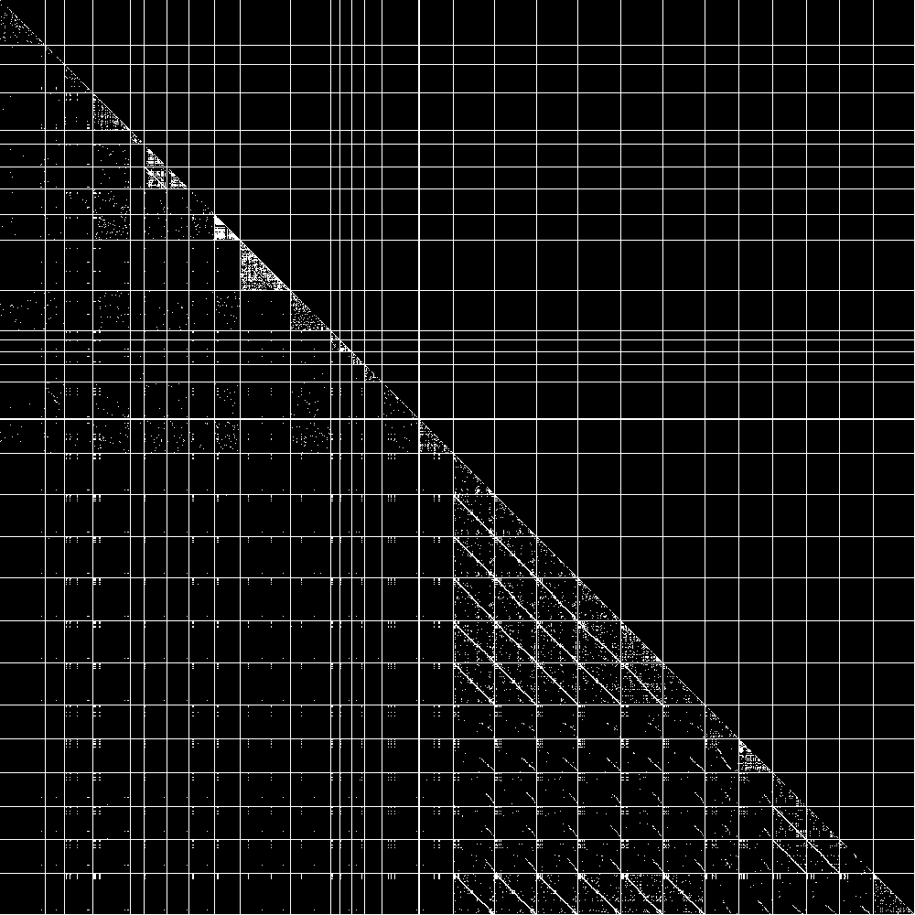
Visualization of Genome Comparison (3)
30 species of Bacteria
・ can compare many species at once, in short time
10 min by PC

Slide 148
Superimpose Many Images by Coloring
・ We can superimpose the comparisons between a fixed string and the other strings, by using many colors
all chr’s of mouse (all start form leftmost)
Human 22nd chr
6 hours by a PC

Slide 149
４．３ Inclusion Relation

Slide 150
問題の定義
入力： 部分集合族（トランザクションデータベース） D = {T₁,…,T_{n}}
（ ただし、各 T_{i} はアイテム集合 E = {1,…,n} の部分集合）
＋ 閾値 θ
出力： |T_{i}∩T_{j}| がθより大きいような、
全てのT_{i} 、T_{j}のペア
例： 閾値 θ=2 のとき、
(A,B), (A,C), (A,D), (A,E)
(C,D), (C,E), (D,E)
A: 1,2,5,6,7
B: 2,3,4,5
C: 1,2,7,8,9
D: 1,7,9
E: 2,7,9
F: 2
D ＝
D が巨大かつ疎で（各Ti が平均的に小さい）、出力の数がそれほど多くない（ ||D|| の数倍）状況での高速化を考える

Slide 151
単純に全対比較すると
A: 1,2,5,6,7
B: 2,3,4,5
C: 1,2,7,8,9
D: 1,7,9
E: 2,7,9
F: 2
・ 単純に全対比較するアルゴリズムを考える
for i=1 to |D|-1
for j=i to |D|
if |T_{i}∩T_{j}|≧ θ then output (T_{i}, T_{j} )
・ 共通部分の計算は、各 T_{i} をアイテム順でソートしておき、T_{i} 、T_{j}をマージソートのように並行してスキャンすればよい。
時間はO(|T_{i} |＋| T_{j}|)
・ 全体の計算時間は ∑_{i,j}(|T_{i} |＋| T_{j}|) = 2n ||D||
D ＝
かなり時間がかかると見てよい

Slide 152
振り分けによる高速化
・各T_{i} に対し、|T_{i}∩T_{j}|がθ以上になるものを見つける問題を考える
・ 各アイテム e に対して、e を含む部分集合の集合を D(e) とする
・ T_{i} が含む各 e に対して、D(e) の各 T に対して、カウントを１つ増やす、という作業をする
➔ 全ての e∈T_{i} についてこの作業をすると、各 T_{j} のカウントは |T_{i}∩T_{j}| になる
for each e∈T_{i}
for each T_{j}∈ D(e), j>i, do c(T)++
・ D(e) を添え字順にソートしておくと、j>i である
T_{j}∈ D(e) を見つけるのも簡単
A: 1,2,5,6,7
B: 2,3,4,5
C: 1,2,7,8,9
D: 1,7,9
E: 2,7,9
F: 2
D ＝

Slide 153
振り分けの計算時間
for each e∈T_{i}
for each T_{j}∈ D(e), j>i, do c(T)++
・ 計算時間は
∑_{j} ∑_{e∈Ti} |{ T_{j}∈D(e), i<j}| ＝ ∑_{e} |D(e)|²
➔ |D(e)| が平均的に小さければ、かなり速い
A: 1,2,5,6,7
B: 2,3,4,5
C: 1,2,7,8,9
D: 1,7,9
E: 2,7,9
F: 2
D ＝

Slide 154
1再帰呼び出しの計算時間のイメージ
・ 普通に頻出度の計算をすると
各 X＋e に対してデータを
一回スキャンする
・ 共通部分による計算は
D(e) と D(e) のをスキャンする
➔ D(X) を n-t 回スキャンし、
データベースの t より大きな
アイテムをスキャンする
・ 振り分けは D(X) に含まれるトランザ
クションの t のをスキャンする t より
大きなアイテムをスキャンする
(n-t)個
＋
(n-t)個
t
t

Slide 155
計算実験
・ webリンクのデータの一部を使用
－ ノード数 550万、枝数1300万
－ Pentium4 3.2GHz、メモリ2GB
・ リンク先 20個以上 288684個、20個以上共有する
ペア数が143683844個、計算時間、約8分 ・ リンク元 20個以上が 138914個、20個以上共有する
ペア数が18846527個、計算時間、約3分 ・ 方向を無視して、リンクが 100個以上あるものが 152131個、
100個以上共有するペア数が32451468個、計算時間、約7分 ・方向を無視して、リンクが20個以上あるものが370377 個、
20個以上共有するペア数が152919813個、計算時間、約14分

Slide 156
簡単に追加できる条件
・ |A∩B| が、|A| のα倍以上 、(and/or) |B| のα倍以上
・ |A∩B| / |A∪B| ≧ α
・ |A∪B| －|A∩B| ≦ θ
など。
この手の、共通部分や和集合の大きさから計算できる評価値であれば、簡単に評価できる
・ 計算時間は、ほぼ線形で増えていくと思われるので、多少大きなデータでも大丈夫

Slide 157
Conclusion
・ Prospect of enumeration: unknown objective and unsorted data
・ Difficulty of enumeration: proper approach to each problem
・ Technique for speeding up: using bottom-wideness
－ frequent itemset: database reduction
－ maximal clique: updating adjacency degree
・ Approach for difficult problems:
－ brunch and bound: pruning and exhaust search
－ Maximal cliques: use of sophisticated adjacency
Enjoy interesting researches and businesses

Slide 158
References
・ Frequent itemsets and applications (’90～) numerous
search by “frequent pattern” / ”frequent itemset”
・ Maximal frequent itemsets (’90～) pretty numerous
search by “maximal frequent itemset”
・ pasquer et. al. (‘99) intruduction of closed itemset
・ Closed itemset (’99～) search by “closed pattern” “formal concept”
“maximal bipartite clique”…
・ Uno et. al. LCM ver.2 (‘04) fastest implementation
http://research.nii.ac.jp/~uno/
・ Frequent itemset repository (papers, implementations, experiments)
http://fimi.cs.helsinki.fi/
・ Nakano et. al. （’03～ ） enumeration of ordered/unordered trees

Slide 159
References of Clique Enumeration
・ Tsukiyama et. Al. (‘78) First polynomial time algorithm
・ Makino & Uno (‘03) Improvement for large scale sparse data
・ Tomita et. al. (‘04) Efficient pruining, fast even for dense graphs
・ Numerous studies on applications (Nature etc.)
search by “clustering clique” etc.
・ Implementation MACE: (MAximal Clique Enumerator) Makino&Uno
MACE_GO: Tomita et. al.
Uno’s Website http:research.nii.ac.jp/~uno/

Slide 160
５． Exercise

Slide 161
Lv. 1 ：Brute Force
① Design an algorithm to enumerate all combinations of integers a₁,...,a₁₀ ranging 1 to 10 such that a₂ + a₄ + a₆ = 20, a₁ + a₃ + a₅ = 10, a₁ + a₇ + a₉ = 10, a₂ + a₈ + a₁₀ = 20. Brute force is OK.
② Design an algorithm to enumerate all graphs of n vertices and m edges so that no two isomorphic graphs will be enumerated. We are given a function to check isomorphism of given two graphs G₁ and G₂. Brute force is OK.
③ Design an algorithm to enumerate all ways to put marks on vertices in a cycle of n vertices, so that no two solutions will be the same by a rotation.

Slide 162
Lv. 1: Brute Force 2
④ Using algorithm ②, we want to design an algorithm for enumerating all graphs including no clique of size 4. Design an efficient pruning method
⑤ Using algorithm ②, we want to design an algorithm for enumerating all graphs such that there is a vertex v such that distance from the given vertex r to v is at least k. Design an efficient pruning method .
⑥ Using algorithm ②, we want to design an algorithm for enumerating all graphs such that the degree of any vertex is at most k. . Design an efficient pruning method .

Slide 163
Lv.1: Speed up
⑦ We want to design an algorithm for enumerating four cycles (cycles of length four) in a huge sparse graph. When the algorithm recursively adds an edge, how can we speed up iterations by removing unnecessary parts from input graphs recursively.
⑧ For given m permutations of 1,…,n, we want to enumerate all subsequences appearing at least k of them. How can we reduce the database to reduce the computation time?
(subsequence is a sequence of numbers such that the numbers appear in the sequence without changing the order. For example, (1,2,3) is a subsequence of (1,4,2,5,6,3).
⑨ We want to enumerate independent sets (no two vertices are connected). What data structure can we update to speed up iterations?

Slide 164
Lv.2: Speed up
⑩ We can construct an algorithm for enumerating all paths connecting given vertices s and t, by adding an edges one by one recursively. For large scale graphs, what should we do for modeling, and speeding up?
⑪ グラフWe first find a triangle X from a graph and iteratively add vertices to X which is adjacent to at least 3 vertices of X, to make a cluster (we do this to enumerate clusters). How can we make the algorithm efficient?
⑫ A leaf-elimination ordering of a tree T is a vertex ordering obtained by removing leaves of T iteratively. Design an algorithm for enumerating all leaf-elimination ordering, and way to speed up.
Discuss about the complexity.

Slide 165
Lv. 2: Search
⑬ For two perfect matchings M and M’ of a bipartite graph G, the symmetric difference between M and M’ is composed of disjoint cycles. Further, the symmetric difference between M and an alternating cycle in which edges of M and edges not in M appear alternatively results a perfect matching different from M. Design a binary partition algorithm by using this fact.
⑭ We want enumerate all pseudo cliques that are subgraphs of edge density at least θ. Investigate the subgraphs obtained by removing a vertex from a pseudo clique, design a parent-child relation, and polynomial time algorithm for the enumreation.
⑮ What kind of techniques should we use to speed up the algorithm of ⑭ in large scale graphs?

Slide 166
Lv. 2: Etc.
⑯ For given a set of axis-parallel rectangles in a plane, we want to enumerate all rectangles obtained by intersecting of some rectangles in the set. Discuss available enumeration techniques, and #solutions.
⑰ A decreasing sequence of numbers a₁,...,a_{n} is a subsequence b₁,...,b_{m} s.t. b_{i} > b_{i+1} holds for any i (subsequence is a sequence of numbers that appears in a₁,...,a_{n} without changing the order). Design an algorithm to enumerate all “maximal” decreasing ordering (we assume that no two numbers are the same).
⑱ For a Markov chain defined on state set V, design an algorithm to enumerate all state sequences starting from S∈V, with moving 10 times. Discuss about speeding up.

Slide 167
Lv. 3
⑲ Design an algorithm for enumerating all vertex sets U of a graph G=(V,E) s.t. the maximum degree in G[U] is at most k. Discuss about speeding up, and existence of polynomial time algorithm for enumerate only maximal ones.
⑳ Estimate the complexities of the algorithm for enumerating spanning trees described in the lecture.
21 For given a database whose records are graphs having a common vertex set, design an algorithm for enumerating pairs of graphs s.t., the symmetric difference between them is composed of at most k edges.

