Slide 1
Testing Assignments of Boolean CSP’s
Arnab Bhattacharyya and Yuichi Yoshida
DIMACS/Rutgers and National Institute for Informatics

Slide 2
Constraint Satisfaction Problems
CSP(Γ) instance
CSP instance
$$x_{1},x_{2},…, x_{7}∈\{0,1\}$$
$$Equal\left(x_{1},x_{2}\right)$$
Domain = $\{0,1\}$
$$IsOdd\left(x_{1}+x_{4}+x_{7}\right)$$
$$Maj\left(x_{2},{x_{6}, x}_{7} \right)$$
Constraint Language Γ = $\left\{\begin{aligned}Equal\left(⋅, ⋅\right), IsOdd\left(⋅\right), \\ Maj\left(⋅, ⋅, ⋅\right), Zero\left(⋅\right)\end{aligned}\right\}$
$$Zero\left(x_{3}\right)$$

Slide 3
Constraint Satisfaction Problems
$$Γ$$
finite collection of relations on domain
CSP($Γ)$
Set of instances defined by constraints using relations from Γ
Computational problem: Given instance of CSP($Γ$), is there an assignment to the variables satisfying all constraints?

Slide 4
Examples
$k$-COLORABILITY: $Γ=\{≠\}$ over domain $\left[k\right]$
2-SAT: $Γ=\{θ_{x∨y}, θ_{x∨\overline{y}},θ_{\overline{x}∨y}, θ_{\overline{x}∨\overline{y}}\}$ over domain $\left\{0,1\right\}$. Similarly, $k$-SAT
3-LIN over ${\text{𝔽}}_{2}$
Horn 3-SAT

Slide 5
Computational Complexity
Clearly, CSP($Γ$) in NP for all $Γ$.
Schaefer’s Theorem (1977): For Boolean domain, CSP($Γ$) is NP-complete unless every instance is:
Satisfied by all-ones or all-zeroes assignment
Is a Horn-SAT or Dual Horn-SAT instance
Is a 2-SAT instance
Is a system of linear equations over ${\text{𝔽}}_{2}$
Dichotomy also shown over {0,1,2} (Bulatov, 2003) and conjectured over all finite domains (Feder-Vardi, 1999)

Slide 6
Testing CSP assignments
How does $Γ$ affect worst-case query complexity?
Can we quickly “test” if an assignment satisfies a CSP($Γ$) instance?
Testing problem: For a parameter $ε>0$ and instance $φ$ of CSP($Γ$) on $n$ variables and domain $D$,
INPUT: $x∈D^{n}$
MODEL: Query access to coordinates of $x$
OUTPUT: YES if $x$ satisfies $φ$, NO if $Δ\left(x,y\right)>εn$ for all satisfying assignments $y$

Slide 7
What’s known?
CSP($≤$), 2-SAT testable with $Ω(\log{n/\log{\log{n), }}}$ $O(\sqrt{n})$ queries (FLNRRS ‘02).
3-LIN, 3-SAT require $Ω(n)$ queries (BHR ‘06)
Can we characterize exactly when constraint languages $Γ$ over Boolean domain are sublinear-query testable?

Slide 8
Aren’t we too optimistic?
Infinitely many relations, infinitely many $Γ$’s…what structure of constraint languages can we expect to use?

Slide 9
Aren’t we too optimistic? NO ☺
Infinitely many relations, infinitely many $Γ$’s…what structure of constraint languages can we expect to use?
Turns out that we can restrict ourselves to $Γ$’s that naturally define an algebra. And we can use algebraic properties to classify query complexity of Boolean CSP’s!

Slide 10
From Relations to Algebra
Closed under compositions and contains projections: a clone
Define Pol($Γ)=\bigcap_{R∈Γ}{Pol(R)}$

Slide 11
Polymorphisms determine complexity
Theorem (Yoshida ‘12): If CSP($Γ)$ is testable with $q(n,m,ε)$ queries, then any $Γ^{′}$ with Pol($Γ$) = Pol($Γ^{′}$) is testable with $O\left(\frac{1}{ε}\right)+q(O\left(n+m\right),O\left(m\right), O\left(ε\right))$ queries.

Slide 12
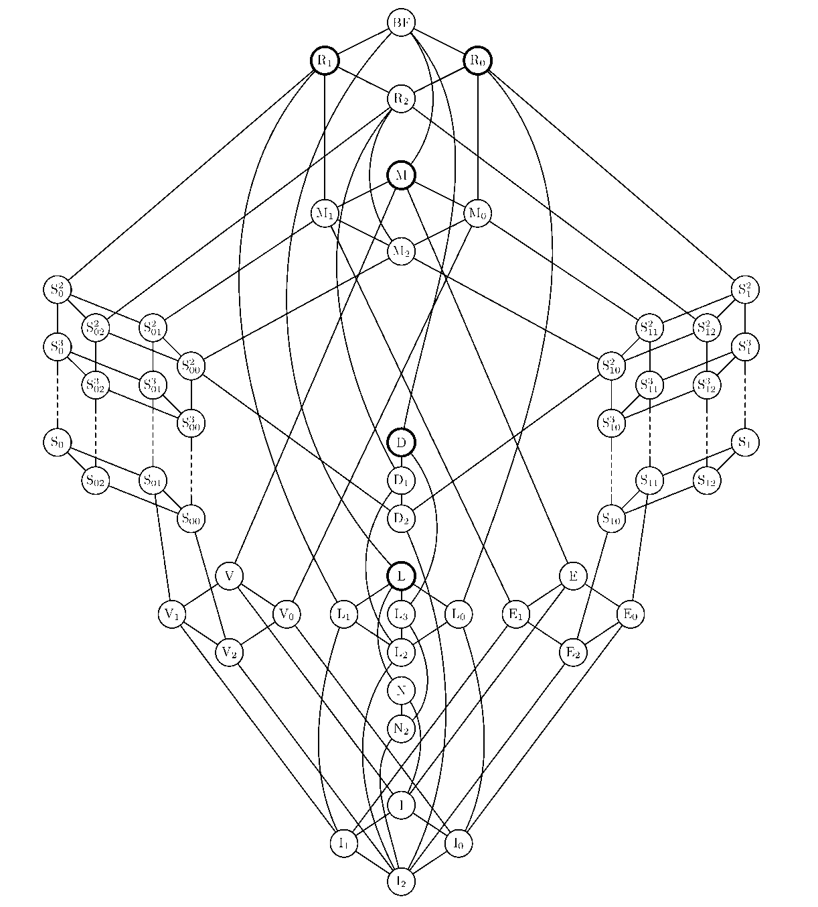
Post’s Lattice
Inclusion structure
of Boolean clones

Slide 13
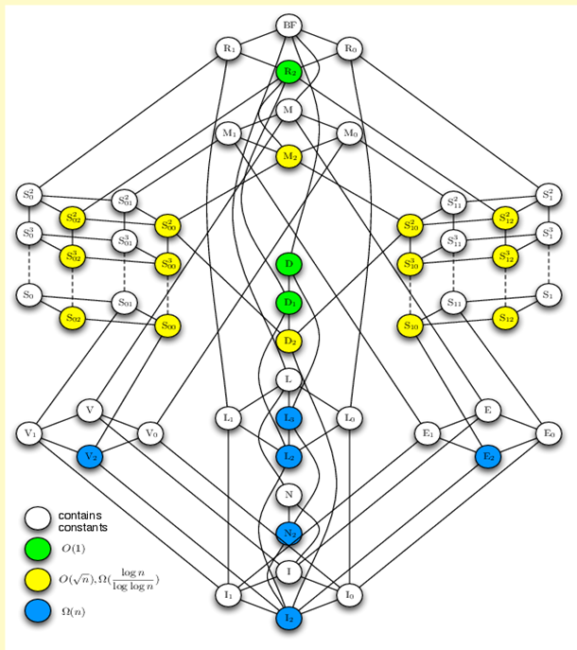
Main result
CSP($≤)$
Contains NU;
$$O(n^{1−1/k})$$
2-SAT
$$O\left(1\right)$$
$$n^{O(1)},$$
$$Ω\left(\frac{\log{n}}{\log{\log{n}}}\right)$$
Horn 3-SAT
$$Ω(n)$$
0-valid or
1-valid
Affine
NAE 3-SAT

Slide 14
Components of the Result
Pre-existing bounds from (FLNRRS ‘02) , (BHR ‘06), and (Yoshida ‘12) plus:
$Ω(n)$ lower bound for testing Horn 3-SAT instances
$O\left(n^{1−1/k}\right)$ upper bound for testing CSP($Γ)$ when Pol($Γ$) contains a weak near-unanimity operation

Slide 15
Horn 3-SAT
Each constraint is a disjunctive clause of at most 3 variables with at most one positive literal:
$$\left(\overline{x}∨\overline{y}∨z\right),\left(\overline{x}∨\overline{y}∨\overline{z}\right), z$$
Can be solved in polynomial time by unit propagation

Slide 16
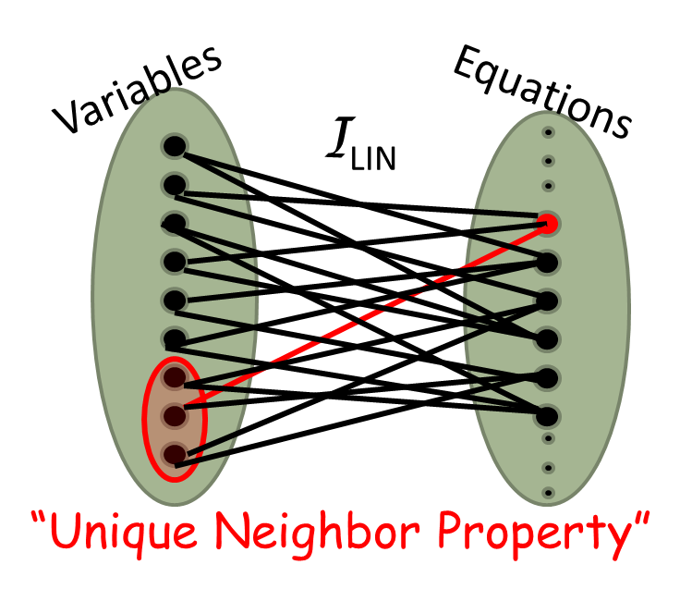
Proof of Linear Lower Bound
Reduce to testing hard instance of 3-LIN

Slide 17
Hard Horn 3-SAT instance

Slide 18
Reduction to 3-LIN

Slide 19
Open Questions
More connections between theory of CSP’s and property testing?
Classification of testing non-Boolean CSP’s?

